Slide 1
Tips for a great conference!
Rate this presentation on the conference app www.nctm.org/confapp
Download available presentation handouts from the Online Planner! www.nctm.org/planner
Join the conversation! Tweet us using the hashtag #NCTMHouston

Slide 2
2014 NCTM Regional in Houston, TX
“Equity Connections
with High School Probability/Statistics Content”
Dr. Larry Lesser, Professor at UT-El Paso (Lesser@utep.edu)
and a former HS teacher here in Houston!
founding co-editor of
Teaching for Excellence and Equity in Mathematics,
refereed journal of the NCTM affiliate organization
TODOS: Mathematics for ALL
www.todos-math.org/teem
Notes:
What did the acorn say when he grew up?

Slide 3
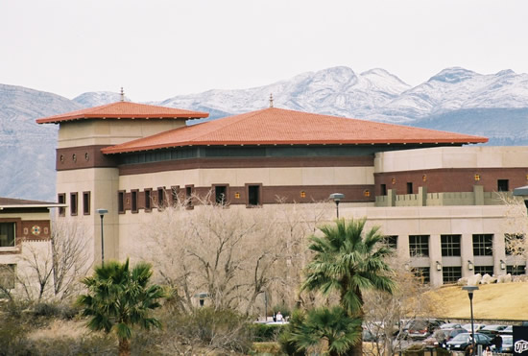
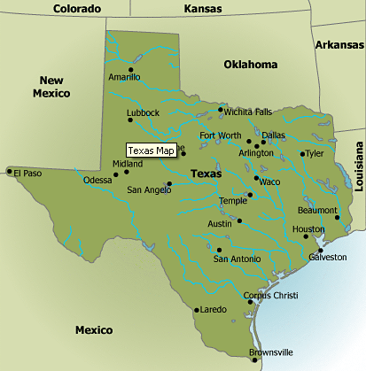
The University of Texas at El Paso,
the only doctoral research intensive university in US
with student body that’s mostly Mexican-American;
ranked #1 (in 2012, 2013, 2014) by Washington Monthly in social mobility (recruitment & graduation of low-income students)
ranked #1 in 2014 by Diverse Issues in Higher Education in math/stat degrees awarded to Hispanics
(see “Mathematical Lens” in Sept. 2008 MT)
Notes:
What did the acorn say when he grew up?

Slide 4
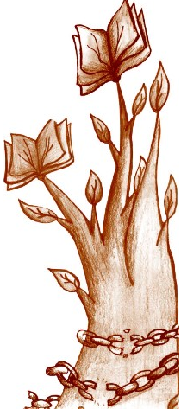
some of my equity-related papers
Diversity (ICOTS8)
Ethnostatistics (June 2010 Notices of the NASGEm)
English language learners (Nov. 2009, Nov. 2013 SERJ)
Equity (Oct. 2009 TEEM)
Stereotype Threat (April 2014 MT)
Ethics (Nov. 2004 JSE)
Social justice (March 2007JSE;
2007 CAUSE & 2008 ASA webinars)
Service learning (paper from 2008 JSM)
Links/papers on these and more:
www.math.utep.edu/Faculty/lesser/equity.html

Slide 5
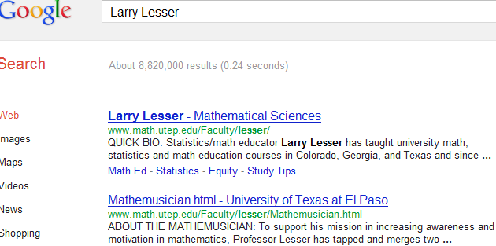
for pages on equity (or lottery literacy, pi day, math songs, etc.), just Google me!

Slide 6
some recent equity highlights
first principle of PSSM (NCTM, 2000)
first Math & Social Justice conference (2007)
first Math Ed. Equity Summit (Feb. 2008):
AMTE, BBA, NASGEm, NCSM, NCTM, TODOS, WME
1st principle of PRIME Leadership Framework (NCSM, 2008)
NCTM: 2008 Position Statement, first Iris M. Carl Equity Address (at 2008 annual meeting), 2008-09 PD focus (& resource webpage), Mathematics for Every Student: Responding to Diversity books for 3 grade bands, 2010 JRME focus issue
TODOS Mathematics for ALL: launches Teaching for Excellence and Equity in Mathematics in 2009
AMTE: J. of Math. Teacher Education equity issue in 2011

Slide 7
Some rationale
Critical thinking (e.g., operational definitions)
Connections with other subjects
Student motivation and engagement
Empower students from historically underrepresented groups to gain the tools to recognize and describe inequities
Real data (a GAISE recommendation)

Slide 8
opportunities in PreK-12 GAISE to explore equity:
Level A: “teachers pose questions of interest”,
“beginning awareness of group to group”
Level B: “students begin to pose own questions of interest”, “questions not restricted to the classroom”,
“beginning awareness of design for differences”,
“compare group to group in displays”,
“note difference between 2 groups with different conditions”
Level C: “students pose own questions of interest”, “students make design for differences”,
“compare group to group using displays & measures of variability”, “quantification of association”

Slide 9
what Common Core mathematical practices might support equity?
“Make sense of problems and persevere in solving them”
“Construct viable arguments and critique reasoning of others”
“Model with mathematics” (“…problems arising in everyday life, society…”)

Slide 10
evidence of engagement?
Gutstein (2003) informally found far more student engagement when his middle-school students made a scatterplot of SAT scores and family income than when they made a (much more conventional “real-world”) scatterplot of heights of children and same-sex parent.
As a followup, Lesser (2006) did a related randomized experiment that showed that college introductory statistics students (N = 160) on the first day of class rated an example with the equity context (SAT and family income) significantly (p-value = .05) more interesting than one with a conventional consumer paradigm (house price and family income). Finding supported by qualitative analysis of explanations students gave for their ratings.
Makar (2004) investigated a course for preservice teachers designed to develop understanding of equity through data-based statistical inquiry. Makar found a significant correlation between prospective teachers’ degree of engagement with their topic of inquiry and the depth of statistical evidence they used, particularly for minority students

Slide 11
but is equity an “add-on”?
not if it’s a VEHICLE to engage with:
Data analysis
Randomness
Probability
Independence
Expected value (e.g., of a “fair share”)
Descriptive Statistics
Inferential Statistics

Slide 12
Math/stat needed to explore equity! (Lesser 2007)
Tools to identify group differences or patterns can help people recognize, analyze or address social inequalities
Calculating expected value of a “fair share” and how much deviation might be viewed as innocuous offers a benchmark to discussions about what is “fair.”

Slide 13
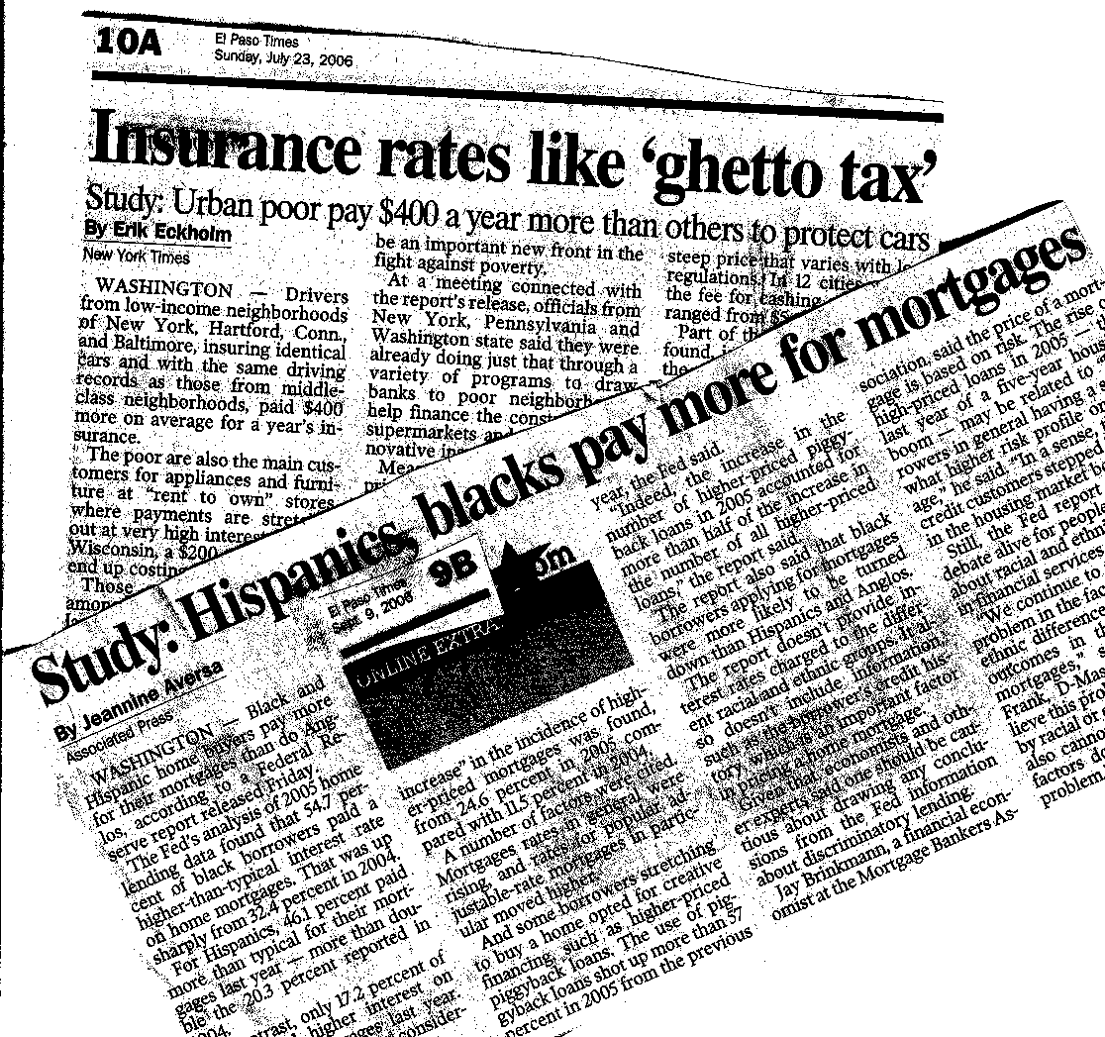
equity is often in the media

Slide 14
Areas for data-based explorations of equity identified by Pollack & Wunderlich (table in June 2005 Amstat News is reproduced in Lesser 2007)
Labor markets: hiring, interviewing, wages, evaluation, promotion, layoffs, rehiring
Education: college acceptance, financial aid, track placement, evaluation, special ed. placement, promotion
Housing: steering, mortgage redlining, loan pricing, resale value; wealth accumulation
Criminal justice: police behaviors, arrests, police treatment, legal representation, parole, sentencing
Health care: access, insurance, quality, price, referrals

Slide 15
Assumption:
Each instructor is the best judge
of what examples
work best with his/her students.

Slide 16
Like it or not, our students’ concepts of “fairness” affect how they encounter content (Vogt 2007; Shaughnessy 2007; Lesser 2008, 2009)
Random selection of survey participants:
some students believe process should be choice, not chance; others believe all demographic groups must be represented [proportionally]
Random assignment of experimental treatments: some students believe treatment resources should go to neediest, not luckiest

Slide 17
Like it or not, our students’ concepts of “fairness” affect how they encounter content (Vogt 2007; Shaughnessy 2007; Lesser 2008, 2009)
students felt having a 50% chance at the larger piece of cake (which implies an expected value of half the cake) was less fair than “you cut, I choose”
VERIFY: suppose “x” amount of cake is cut into two pieces, one twice as big as the other:
2x/3 and x/3
If you flip a coin to pick your piece, the expected value is…..

Slide 18
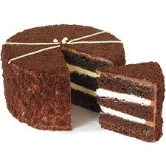
Like it or not, our students’ concepts of “fairness” affect how they encounter content (Vogt 2007; Shaughnessy 2007; Lesser 2008, 2009)
EXAMPLE: suppose “x” amount of cake is cut into two pieces, one twice as big as the other: 2x/3 and x/3
If you flip a coin to pick your piece, EV =
(1/2)*(2x/3) + (1/2)*(x/3) =
x/3 + x/6 = x/2 = HALF the cake!
More generally, if the pieces have sizes “a” and “x-a”,
(1/2)*(a) + (1/2)*(x-a) = x/2 = HALF the cake

Slide 19
Like it or not, our students’ concepts of “fairness” affect how they encounter content (Vogt 2007; Shaughnessy 2007; Lesser 2008, 2009)
Matter-of-fact statistics words like “bias” or “discrimination” may get confounded by students with their prior experience with equity language
Example: Will students interpret
“the survey question is biased”
as “some racist guy wrote it” or
“the question underestimates a parameter” ?

Slide 20
Power of statistics to detect “invisible” prejudice! (Lesser, 2010)
Disguised-gender experiments show adults perceive baby girls and boys differently
Males randomly assigned to view tape of + or – feedback more likely deem deliverer of – feedback as incompetent if female
stereotype experiments reviewed in my April 2014 Mathematics Teacher SOUNDoff
Internet field experiment shows discrimination against same sex couples on housing market

Slide 21
Power of statistics to detect “invisible” prejudice! (Lesser, 2010)
Randomized Response (Warner, 1965)
Simple version:
State yes/no question where YES is “sensitive”.
Each person privately flips coin.
If HEADS, say “YES”. If TAILS, answer truthfully.
Example:
Suppose when 50 students are asked with RR “Are girls innately worse at math than boys?”,
we get 32 YESes and 18 NOs.
Estimate proportion who believe girls are worse.

Slide 22
Power of statistics to detect “invisible” prejudice! (Lesser, 2010)
Randomized Response (Warner, 1965)
If HEADS, say “YES”. If TAILS, answer truthfully.
Example:
Suppose when 50 students are asked with RR “Are girls innately worse at math than boys?”,
we get 32 YESes and 18 NOs.
We estimate 36 NOs, which ➔ 50-36 = 14 YESes, so 14/50 = .28 of sample is estimated as true YES.
(Note: other RR versions can handle questions where YES and NO are both sensitive.)

Slide 23
Power of statistics to detect “invisible” prejudice! (Lesser, 2010)
Example of “list experiment” (adapted from Kulinski et al., 1997):
From your list of items, state how many upset you:
The US government increasing the gasoline tax.
Pro athletes getting million-dollar contracts.
Large corporations polluting the environment.
[half the people get a sensitive 4th item inserted]
What could we estimate if the 3-item group had a mean of 1.6 items that upset them, and the 4-item group had a mean of 2.3 items?

Slide 24
Power of statistics to detect “invisible” prejudice! (Lesser, 2010)
Example of “list experiment” (adapted from Kulinski et al., 1997):
the 3-item group had a mean of 1.6 items that upset them, and the 4-item group had a mean of 2.3 items
2.3 – 1.6 = 0.7 = 70%,
so we estimate that 70% of the respondents are upset by the topic in the extra/sensitive item

Slide 26
Raise your hand….
if you’re happy with
the size of your classes
and don’t wish they were smaller

Slide 27
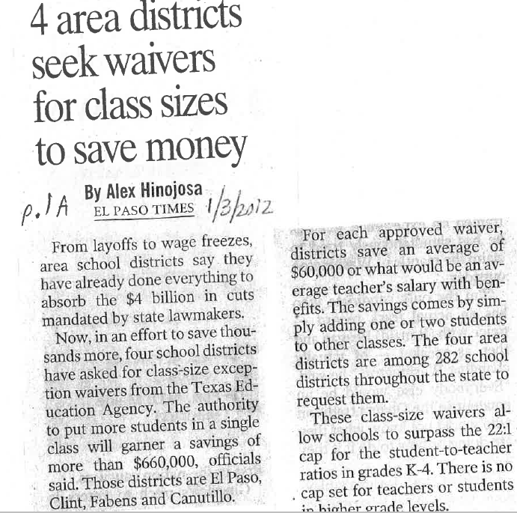

Slide 28
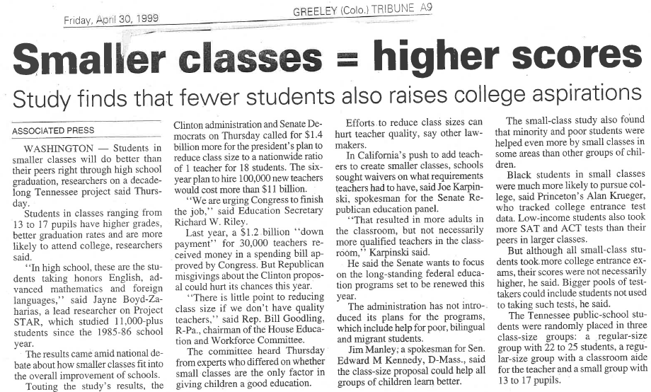

Slide 29
“Average Class Size” Exploration (my MT paper & letter in 2010)
My 2010 Mathematics Teacher article example:
185 students are divided among 7 rooms as: 20, 20, 20, 25, 30, 35, 35.
What would you say is the ‘average class size’?
For speed, let’s use this simpler dataset:
20 students divided among 4 rooms as
3, 3, 4, 10
What would your students likely say is the ‘average class size’?
Go ahead, call something out!

Slide 30
what’s Average Class Size?
Room 1: 3 kids
Room 2: 3 kids
Room 3: 4 kids
Room 4: 10 kids
Common answers I usually get:
5 (mean), 3.5 (median), 3 (mode),
and sometimes 6.5 (midrange)

Slide 31
Average per what?
 | mode | median | mean
Class | 3 | 3.5 | 5
Student | ? | ? | ?
Preceding answers were on per-class basis: {3,3,4,10}. Now, have students use a “per-student basis” with:
{3,3,3, 3,3,3, 4,4,4,4, 10,10,10,10,10,10,10,10,10,10}
Al,Bob,Carl,Dee,Ed,Flo; Gil,Hal,Ivy,Jo; Kay,Lia,Mo,Ned,Olga,Pat,Qing,Ray,Sue,Ted

Slide 32
Average class size per…..?
 | mode | median | mean
Class | 3 | 3.5 | 5
Student | 10 | (10+4)/2 = 7 | 134/20 = 6.7
{3,3,4,10} for per-class basis
{3,3,3, 3,3,3, 4,4,4,4, 10,10,10,10,10,10,10,10,10,10}
for per-student basis

Slide 33
Whole-class debrief
Ambiguity of the word “average”: need to specify not only which average, but also basis unit over which you are averaging!
Which basis results in a larger number?
Which basis is more useful for consumers?
How to count auditing students, online courses, lab/recitation sections, etc.?
Connection to “student-teacher ratio”?

Slide 34
Data used to explore school overcrowding (Turner & Strawhun, in May 2007 TCM)
Teacher asked 6th-graders to consider what data would be needed to compare school to the nearest school
Students collected data on area (hallway, classroom, bathroom) per student
Students presented findings to school and district administrators and a proposed increase in enrollment was avoided

Slide 37
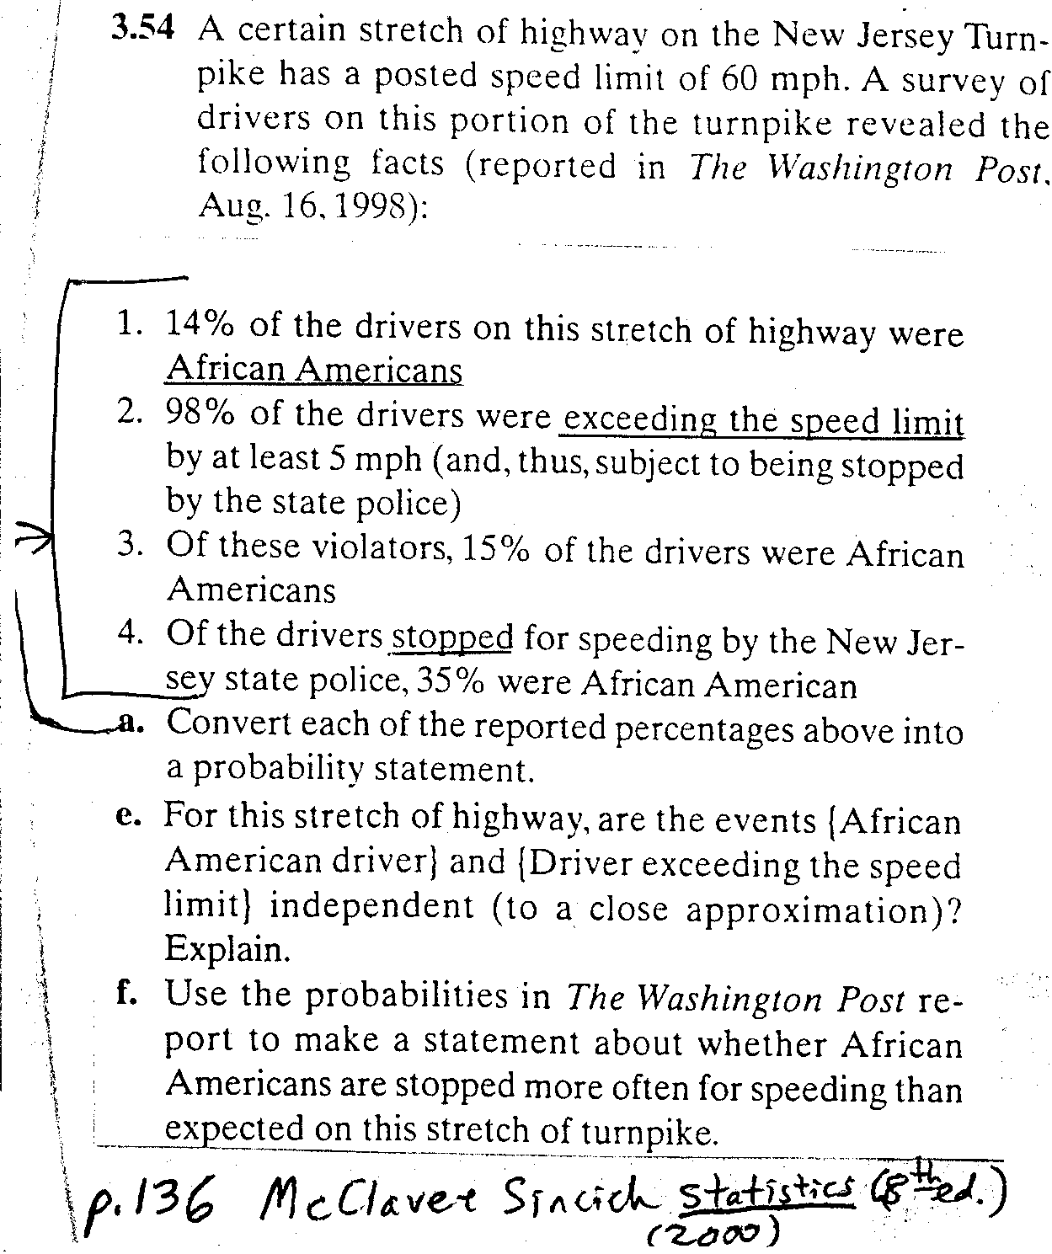

Slide 38
“DWB: Driving while Black/Brown”
Rico Gutstein (2006) middle school lesson is a vehicle for students to learn how to:
analyze data from a probability simulation
(drawing cubes color-coded for ethnicity),
set up a simulation of random traffic stops
(based on 10 years of data from IIlinois), &
examine the relationship between theoretical probabilities (expected values from random traffic stops) and empirical data

Slide 39
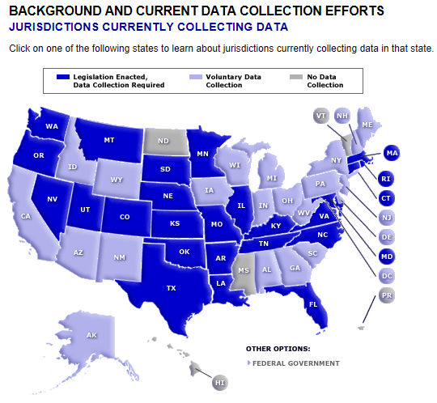
http://www.racialprofilinganalysis.neu.edu/background/jurisdictions.php

Slide 40
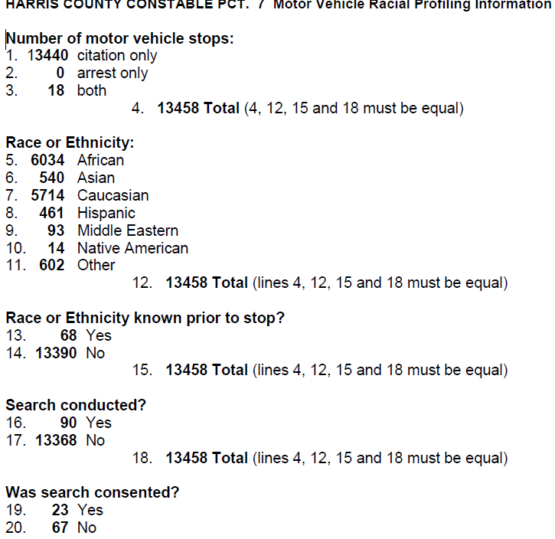
Example profiling report

Slide 41
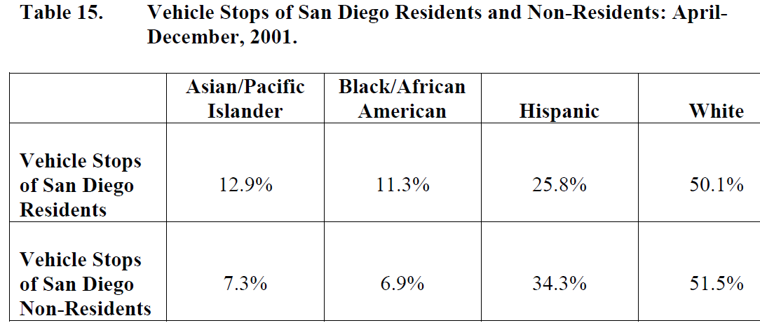

Slide 43
Investigating Hiring Discrimination (Kansas State U.’s J.J. Higgins)
A company will hire 14 people by choosing
at random from a large pool with
equal numbers of equally-qualified M & W.
How likely is hiring 7 M & 7 W?
What deviation from this would feel suspicious?
(8 & 6? 9 & 5? 10 & 4? 11 & 3?
12 & 2? 13 & 1? 14 & 0?)

Slide 44
Motivation for binomial distribution!
Binary outcomes on each trial
(bi-nom; male or female)
Independence of trials
Number (e.g., 14) of trials is fixed
Same probability of success (e.g., “hired person is female”) on each trial

Slide 45
values from formula nCx p^{x}(1-p)^{n-x}, EXCEL binomdist, or TI-84 commands where n =14, p =.5
x (number of successes) | Probability of exactly x successes TI-84’s 2nd DISTR Binompdf(n, p, x) | Probability of x or fewer successes TI-84’s 2nd DISTR Binomcdf(n, p, x)
0 | .000 | .000
1 | .001 | .001
2 | .006 | .006
3 | .022 | .029 (p <.05)
4 | .061 | .090
5 | .122 | .212
6 | .183 | .395
7 | .209 | .605
8 | .183 | .788
9 | .122 | .910
10 | .061 | .971
11 | .022 | .994
12 | .006 | .999
13 | .001 | 1.000
14 | .000 | 1.000

Slide 47
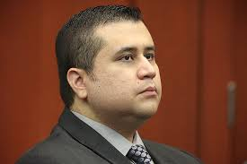
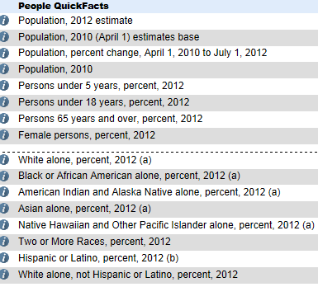
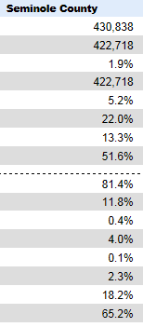
George Zimmerman’s 2013 jury: all women, 5 white, 1 Hispanic
Jury pool came from Seminole County,
described by http://quickfacts.census.gov/ as:

Slide 48
Race questions (p = proportion of that race in jury pool)
Pr(0 blacks on jury)? (1-p)⁶
TI-84: binompdf(6, p, 0)
Pr(no more than 1 Hispanic on jury)?
TI-84: binomcdf(6, p, 1) = 5p(1-p)⁵ + (1 – p)⁶
Pr(at least 5 whites)? 5(1-p)p⁵ + p⁶
TI-84: 1 – binomcdf(6, p, 4)

Slide 49
Gender questions (County proportion of women = .516)
Predict:
A) Pr(all 6 Zimmerman jurors are women) is small
B) Pr(≥1 of 40 six-person juries is all women) is small
C) Both of the above
D) None of the above

Slide 50
Gender questions (p = County proportion of women = .516)
Pr(all 6 Zimmerman jurors are women)?
TI-84: binompdf(6, p, 6) = .516⁶ = 1.89%

Slide 51
Gender questions (p = County proportion of women = .516)
Pr(all 6 Zimmerman jurors are women)?
TI-84: binompdf(6, p, 6) = .516⁶ = 1.89%
Pr(≥1 of 40 six-person juries is all women)? 1 – (1- .0189)⁴⁰ = 54%
(for N = 200 juries, it’s 98%)

Slide 52
more information is available
Pool of 211 people fill out questionnaires
By day 7, 58 are questioned by attorneys
40 of 58 selected for more questioning
Of those 40, 24(60%) are women
So proportion of women is not .516, but .6
does 24/40 significantly differ from .516? No

Slide 53
(hypergeometric) probability of 6W jury from the actual jury pool of 24W,16M
(ways to pick 6 of 24 W) * (ways to pick 0 of 16 M) _______________________________________________________________________________________________________________________________
(ways to pick 6 of 40 people)
= .0351, which is > .0189, but still < .05
Each of these 3 parts is a combination coefficient,
so the first one is: 24→MATH→PRB→nCr→6

Slide 55
How Fair is the Drug Test? (Lyublinskaya in April 2005 MT)
1995 US Supreme Court ruling said random student-athlete drug testing is legal (e.g., initial team test, then test a random 10% each week of season)
Predict: If 3% are drug users and drug test is 99% accurate, what’s probability that someone who tests positive is NOT a user?
A) 1% B) 5% C) 10% D) 25%

Slide 56
wait, is this Bayes Theorem?
P(false positive) = P(nonuser | + test) =
P(+ test | nonuser) x P(nonuser) / P(+ test),
where P(+ test) =
P(+ | user)P(user) + P(+ | nonuser)P(nonuser)

Slide 57
10,000 students; 3% are users
Drug users (300)
Nonusers (9700)

Slide 58
Which cells are “correct” results?
 | Test + | Test -
Drug users (300)
Nonusers (9700)

Slide 59
Which cells are correct results?
 | Test + | Test -
Drug users (300) | RESULT IS CORRECT
Nonusers (9700) |  | RESULT IS CORRECT

Slide 60
What about the other cells?
 | Test + | Test -
Drug users (300) | TEST RESULT IS CORRECT | TEST IS WRONG (“false negative”)
Nonusers (9700) | TEST IS WRONG (“false positive”) | TEST RESULT IS CORRECT

Slide 61
10,000 students; 3% users; test is 99% accurate
 | Test + | Test -
Drug users (300) | .99 x 300 = 297 | .01 x 300 = 3
Nonusers (9700) | .01 x 9700 = 97 (false positive) | .99 x 9700 = 9603

Slide 62
How Fair is the Drug Test? (Lyublinskaya in April 2005 MT)
Predict: If 3% are drug users and drug test is 99% accurate, what’s probability that someone who tests positive is NOT a user?
A) 1% B) 5% C) 10% D) 25%
Pr(is nonuser | tests positive for drug) = .25

Slide 63
Followup (Lyublinskaya in April 2005 MT)
When the fraction of drug users increases, the fraction of false positives ______.

Slide 64
Followup (Lyublinskaya in April 2005 MT)
When the fraction of drug users increases, the fraction of false positives decreases.
Sensitivity analysis (3% users? 99% accuracy?) using spreadsheet
retesting students who test positive: how does that iteratively change probabilities?
yields lots more math: rational function, recursion, logistic growth, differential eq.!
Another application context →

Slide 65
100 terrorists in 10 million people; screening is 99% accurate
 | Test + | Test -
Terrorists (100)
Non-terrorists (9,999,900)

Slide 66
100 terrorists in 10 million people; screening is 99% accurate
 | Test + | Test -
Terrorists (100) | 99 | 1
Non-terrorists (9,999,900)

Slide 67
100 terrorists in 10 million people; screening is 99% accurate
 | Test + | Test -
Terrorists (100) | 99 | 1 false negative
Non-terrorists (9,999,900) | 99,999 false positives | 9,899,901

Slide 69
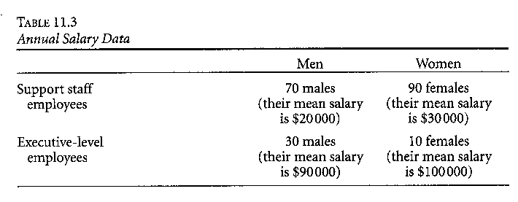
potential pitfall of comparisons (Lesser, 2001)
Find mean salary for the 100 men
Find mean salary for the 100 women

Slide 70
potential pitfall of comparisons (from Lesser (2001)):
Mean salary for men: $41,000
= (70*20,000+30*90,000)/100
Mean salary for women: $37,000
= “90¢ to a man’s dollar”

Slide 71
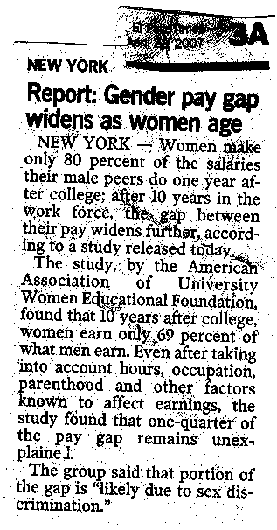
Analyzing gender equity reporting

Slide 72
Importance of Simpson’s paradox
awareness that
a comparison can be affected
by how data is aggregated
is listed by the National Council on Education and the Disciplines (2001)
as essential for democracy
,

Slide 74
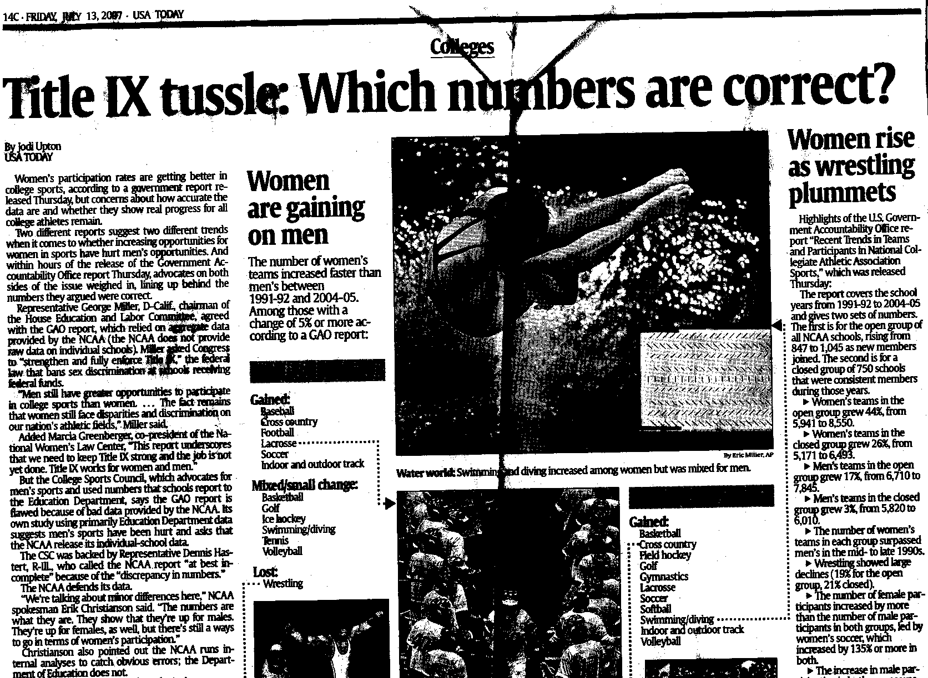

Slide 75
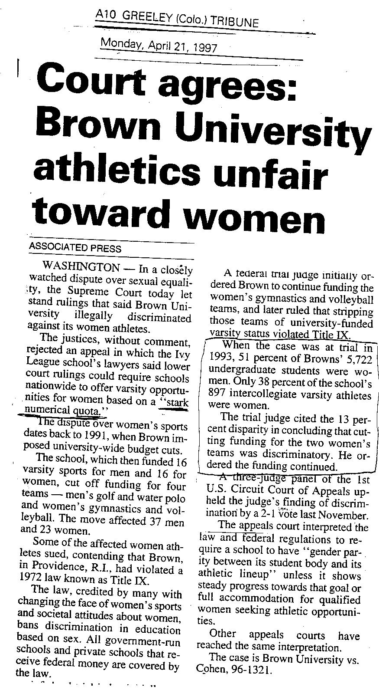

Slide 76
1972 “Title IX” law: federally-funded institutions can’t discriminate on basis of sex
There must be ‘substantial proportionality’ between participation of women in intercollegiate athletics and their representation in the student body.
In 1997, the Supreme Court
ruled against Brown University:
.
 | men | women
student body | 2796 (49%) | 2926 (51%)
athletes | 555 (62%) | 342 (38%)

Slide 78
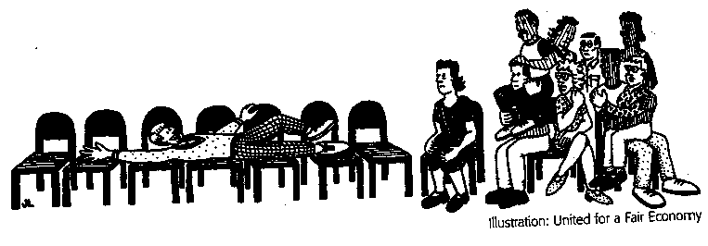
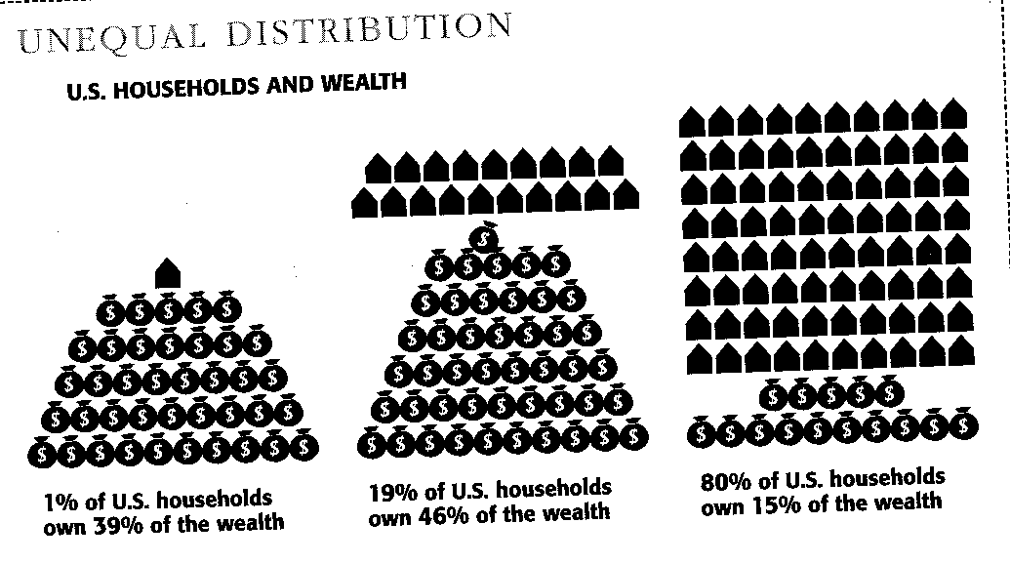
visualizing wealth inequality in US (Gutstein & Peterson, Rethinking Mathematics, 2005)

Slide 79
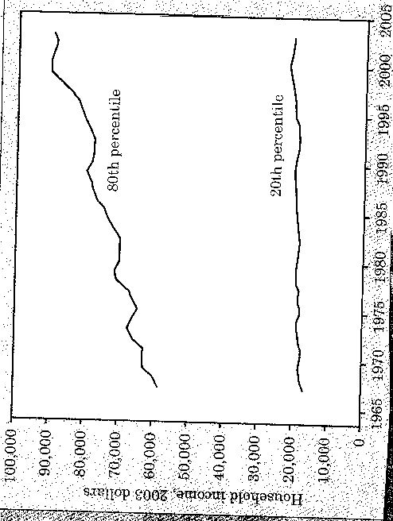
Statistics Concepts and Controversies, 6th ed. Moore & Notz (2006, p. 232)
“Income inequality in the US is greater than in other developed nations and has been increasing. Are these numbers cause for concern? And do they accurately reflect the disparity between the wealthy and the poor? For example, as people get older their income increases. Perhaps these numbers only reflect the disparity between younger and older wage earners. What do you think?”

Slide 80
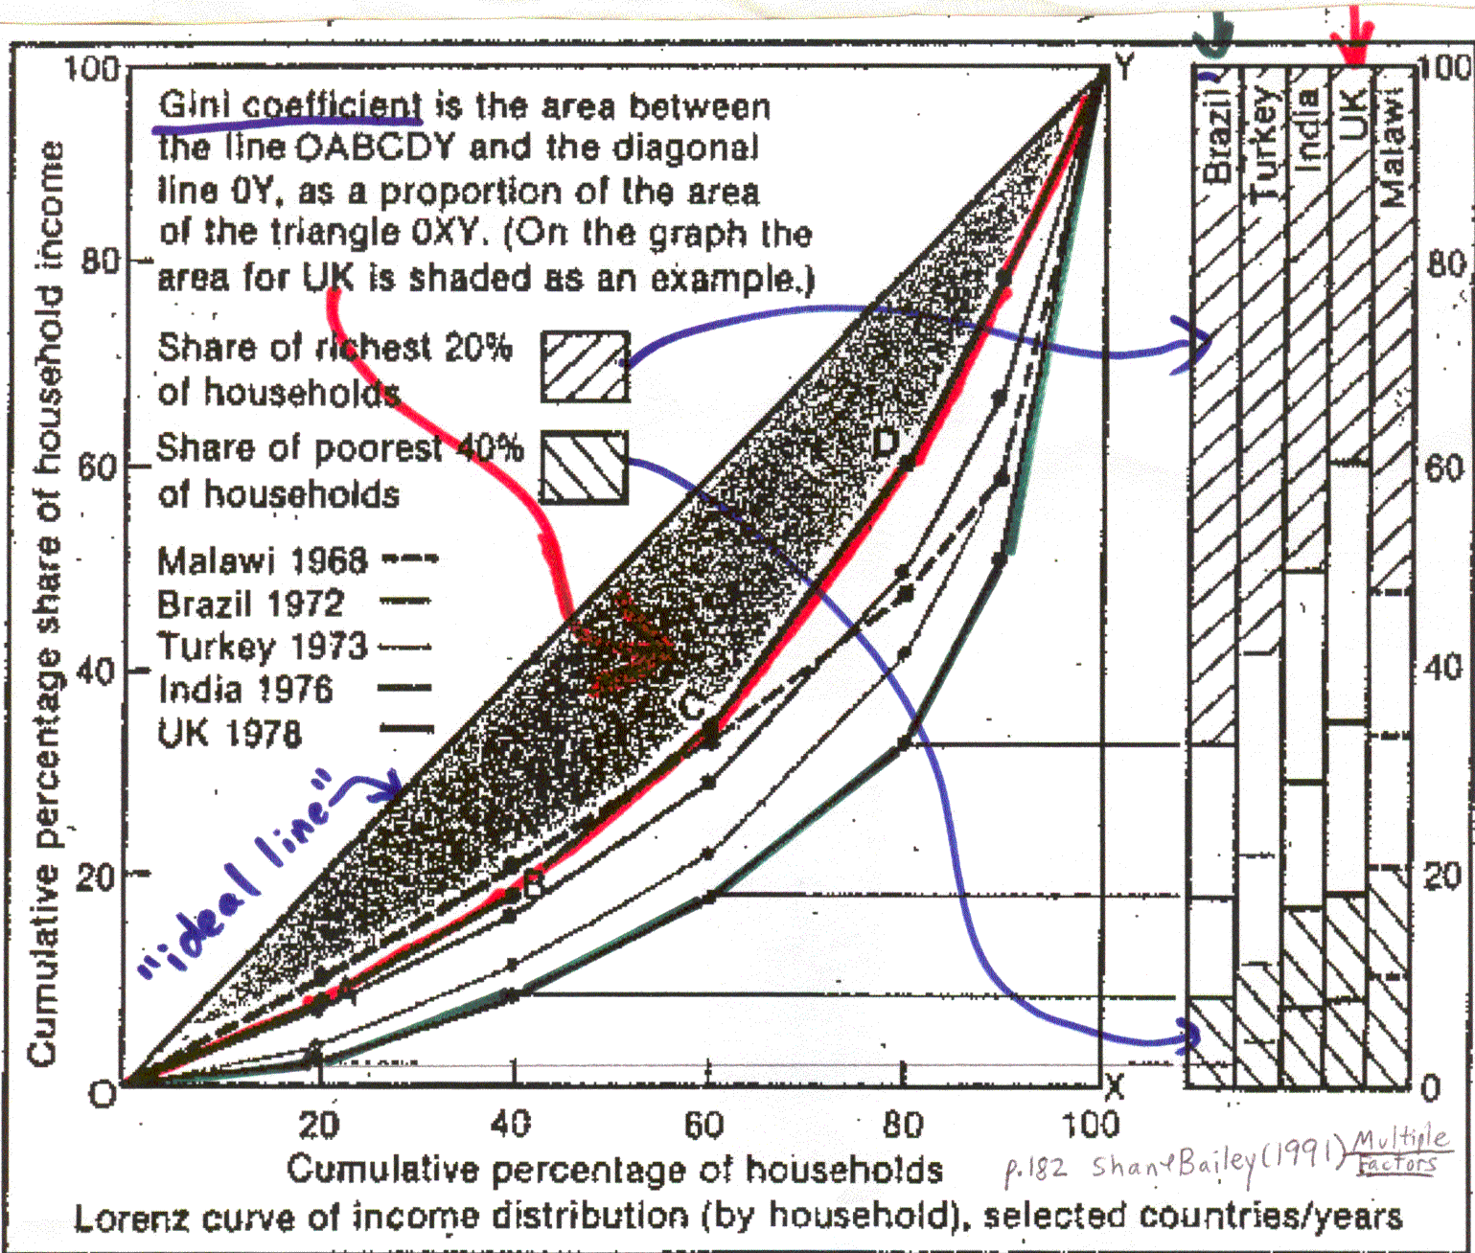

Slide 81
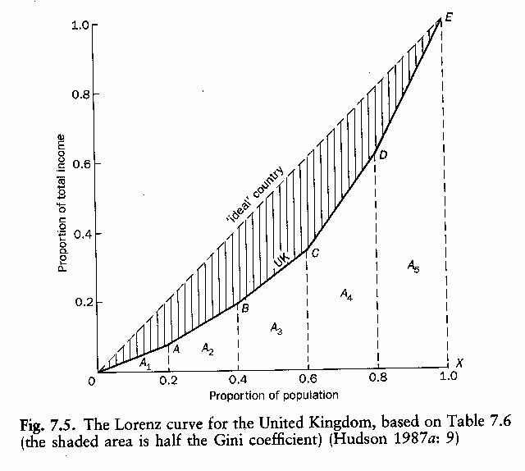
Gini coefficient (in 2005, it was 0.47 for USA household incomes) (Williams & Joseph 1993, p.191)

Slide 82
F. De Maio (2007), p. 34:
“In the minds of many students, statistical analysis bears little relevance to the important issues of the day….[s]tatistical tools which can be used to examine the distribution of income (e.g., the Gini coefficient), the progressivity of tax structures (e.g., the Kakwani index), the nature of poverty (e.g., the Sen index), or health inequities (e.g., illness concentration curves) receive little, if any, attention in most introductory courses...”

Slide 83
What statistical terms help you explain which 5-person universe you’d choose? (Lesser, 2004) .
WORLD 1 | 10 | 10 | 10 | 10 | 10
WORLD 2 | 7 | 7 | 12 | 12 | 12
WORLD 3 | 8 | 8 | 8 | 13 | 13

Slide 85
Equity in the Classroom
Give students from all groups equal opportunities to contribute to discussions and to answer questions of comparable complexity.
Provide opportunities for (non-competitive) collaborative learning, and when forming groups, make sure no group has (for example) only 1 female, and have roles rotate or randomly assigned
Expose students to mathematicians/statisticians of diverse backgrounds.
(example: www.sacnas.org/biography/ for HS & MS)
Connect to equity-related calendar events
(e.g., March 8 is Int’l Women’s Day; March is Women’s History Month;
April 20 is Equal Pay Day http://www.pay-equity.org/day.html)

Slide 86
equity with technology

Slide 87
equity with language
ISI’s online multilingual (31 languages!) statistics glossary (just GOOGLE those words)
multilingual collections of math/statistics applets (e.g., NLVM, Shodor, etc.)

Slide 88
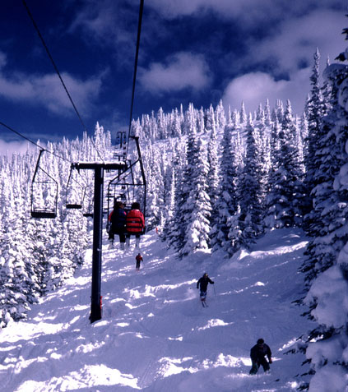
equity with assessment Utts (2005, pp. 214-215, exercise 11.12b), cited in Lesser & Winsor (2009)
Explain the most likely reason
for an observed positive relationship
between number of ski accidents and
average wait time for the ski lift
for each day
during one winter at a ski resort.

Slide 89
not to mention dice, cards, even currency….
interview excerpt from Lesser & Winsor (2009)
M: The second event is ‘quarter lands on tails.’
S2: What is tails on the quarter?
[Mexican coins: seal (or sun) and eagle;
other Latin America: cara[face] y cruz[cross], shield, crown]

Slide 90
Culture can directly impact content
common analogy for hypothesis testing is judicial process (e.g., Martin, 2003),
but H_{o} of “innocent until/unless proven guilty” is reversed for students from a country with Napoleonic Code of Law (Lesser & Winsor, 2009)

Slide 91
Culture effect? (chi-sq = 12.6; p = .006) First day fall 2009 term C.L.A.S.S. given to all 5 Stat 1380 sections (n = 137, 38% identify as Spanish-speaking ELLs)
In statistics, the “null hypothesis” is what we assume is true until there is significant evidence found against it. What would you say is the null hypothesis for a trial in a court of law?
the defendant is innocent
the defendant is guilty
It could be either of the above, depending on what culture you are from
I do not understand the question
 | a | b | c | d
ELL | 38% | 17% | 25% | 19%
Non-ELL | 55% | 13% | 29% | 2%

Slide 92
Some quotations
“highly qualified teachers of mathematics not only understand – but also invest in – the particular culture of their students and school” – NCTM (2005) position statement on highly qualified teachers
culturally relevant mathematics includes the recognition that mathematics has been present in every culture, the mathematical achievements of cultures, the effect of mathematics on any culture, and the right for all people to acquire mathematical power (Hatfield, et al. 2000)

Slide 93
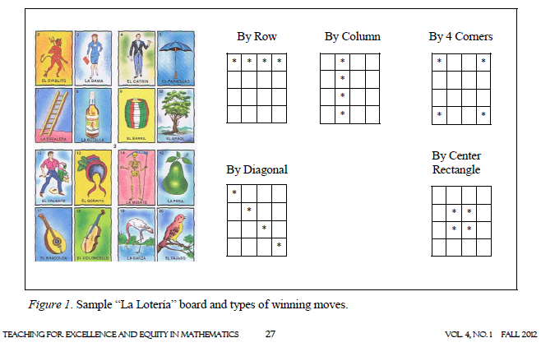
Context for a family math learning event (Ramirez & McCollough, TEEM 2012)

Slide 94
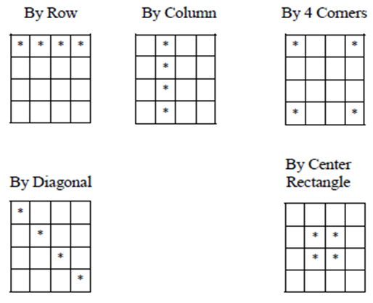
La Lotería questions (Ramirez & McCollough, 2012)
How many ways to win?
How many different 4x4 boards are there if the 16 cells are drawn from a set of 54 distinct images?

Slide 95
La Lotería questions (Ramirez & McCollough, 2012)
How many ways to win? 12
How many different 4x4 game boards if the 16 cells must be different and drawn from a set of 54 images? 54→MATH→PRB→nPr→16 54x53x52x…x39 = 4.41 x10²⁶

Slide 96
more la lotería questions (Lesser, TEEM 2013)
What’s the probability that neither of the first 2 cards called are on your 4x4 board?
What’s the probability that you have a win after the dealer calls exactly 4 cards?

Slide 97
More la lotería questions (Lesser, 2013)
What’s the probability that neither of the first 2 cards called are on your 4x4 board?
(38/54)*(37/53) = .49
What’s the probability that you have a win
after the dealer calls exactly 4 cards?
(# ways 4 cards win) / (# ways to draw 4 cards) = 12 / C(54,4) which is 4/105417 < 1 in 26,000
alternatively: (16/54)(15/53)(14/52)(13/51)(12/C(16,4))

Slide 98
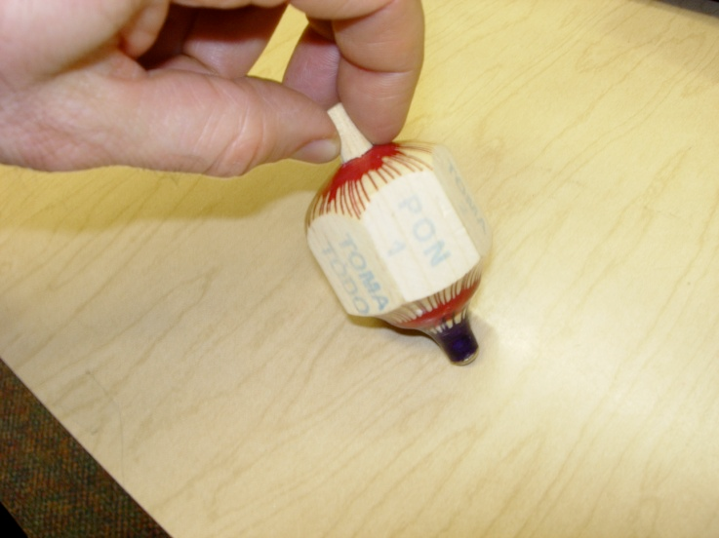
the Mexican game of Toma Todo (Lesser in June 2010 NASGEm News)
face of pirinola | result (S = spinner)
Toma Todo | S takes all
Toma Uno | S takes 1
Toma Dos | S takes 2
Pon Uno | S puts in 1
Pon Dos | S puts in 2
Todos Ponen | Each puts in 2

Slide 99
Toma Todo questions: (Lesser in June 2010 NASGEm News) richer than expected value of rolling dice….
If pot starts with N chips (say, 2 from each player), what is the expected (i.e., mean) value of what is won by the player doing the very first spin?
Does the second player to spin have expected winnings that are less, more or the same as the first player?

Slide 100
(Lesser in June 2010 NASGEm News) Expected winnings from player #1’s first spin: (1/6)(N + 1 + 2 – 1 – 2 – 2) = (N - 2)/6
face of pirinola | Action (S = spinner) | Result for S: | probability
Toma todo | S takes all | +N | 1/6
Toma Uno | S takes 1 | +1 | 1/6
Toma Dos | S takes 2 | +2 | 1/6
Pon Uno | S puts in 1 | -1 | 1/6
Pon Dos | S puts in 2 | -2 | 1/6
Todos Ponen | Each puts in 2 | -2 | 1/6

Slide 101
(Lesser in June 2010 NASGEm News) Expected winnings from player #2’s first spin: (1/6)(7N/6 + 1 + 2 – 1 – 2 – 2) = (7N - 12)/36, which is greater than (N-2)/6 = (6N-12)/36
face of pirinola | result for the player who just spun: | probability
Toma todo | +7N/6, the mean of the (equally) possible pot sizes after player 1’s turn: N, N-1, N-2, N+1, N+2, 2N | 1/6
Toma Uno | +1 | 1/6
Toma Dos | +2 | 1/6
Pon Uno | -1 | 1/6
Pon Dos | -2 | 1/6
Todos Ponen | -2 | 1/6

Slide 102
but (Hanukkah) dreidel game favors 1st player to spin! (Lesser in June 2010 NASGEm News)
face of dreidel | Action (S = spinner)
Gimel | S gets all
Hay | S gets half
Nun | nothing
Shin | S puts in 1

Slide 103
tossing (asymmetric) moon blocks to disrupt equiprobability bias
each crescent-shaped block has flat(yang) and curved(yin) sides
used in China, Hong Kong, Taiwan, etc. to indicate negative (2 yins) or positive (1 of each) fortune
What’s probability of the latter?

Slide 104
exercise 5.12 from FAPP 8/e (2009)
In Malay, the expression for the mean is sama rata, which roughly translates as “same level.”
Take some poker chips and make stacks with 3, 7 and 8 chips. Redistribute chips among the stacks until they are at this same level and explain how this relates to the mean.

Slide 105
Learn your students’ worlds
Survey (find out your students’ favorite music, hobbies, etc.), which can be a class data analysis activity
Community walk (through census tract, noting nearby parks, stores, architecture, geometry of urban space, groceries, stores, cultural/rec centers, etc. to identify evidence of mathematics and resources for lesson planning (Rubel, Chu, Shookhoff in April 2011 MT)

Slide 106
related NCTM resources include
Changing the Faces of Mathematics series
Mathematics for Every Student: Responding to Diversity series
Multicultural Mathematics Materials
Teaching Mathematics for Social Justice: Conversations with Educators

Slide 107
References (more at http://www.math.utep.edu/Faculty/lesser/equity.html)
Gutstein, E. (2006). Driving while black or brown: The mathematics of racial profiling. In J. O. Masingila (Ed.), Teachers Engaged in Research Inquiry into Mathematics Classrooms, Grades 6-8 (pp. 99-118). Charlotte, NC: Information Age Publishing.
Gutstein, E. & Peterson, B. (2005). Rethinking Mathematics: Teaching Social Justice by the Numbers. Milwaukee: Rethinking Schools, Ltd.
Lesser, L. (2007). Critical Values and Transforming Data: Teaching Statistics with Social Justice. Journal of Statistics Education, 15(1), 1-21. http://www.amstat.org/publications/jse/v15n1/lesser.pdf [also, see related 2008 K-12 webinar at http://www.amstat.org/education/webinars/]
Lesser, L. (2009). Equity, Social Justice, and the Mission of TODOS: Connections and Motivations. Teaching for Excellence and Equity in Mathematics, 1(1), 22-27.
Lesser, L. (2009). Social Justice, Gender Equity, and Service Learning in Statistics Education: Lessons Learned from the DOE-Funded Project ACE. Proceedings of the 2008 Joint Statistical Meetings, Section on Statistical Education, pp. 424-431. https://www.amstat.org/membersonly/proceedings/papers/300471.pdf
Lesser, L. (2010). An Ethnomathematics Spin on Statistics Class. Notices of the North American Study Group in Ethnomathematics (NASGEm News), 3(2), 5-6. http://nasgem.rpi.edu/files/2055/
Lesser, L. (2010). Equity and the increasingly diverse tertiary student population: challenges and opportunities in statistics education. Proceedings of the Eighth International Conference on Teaching Statistics. http://iase-web.org/documents/papers/icots8/ICOTS8_3G3_LESSER.pdf
Lesser, L. (2011). Supporting Learners of Varying Levels of English Proficiency. Statistics Teacher Network, 77, 2-5. http://www.amstat.org/education/stn/pdfs/STN77.pdf
Lesser, L. (April 2014). Staring down stereotypes. Mathematics Teacher, 107(8), 568-571.
Lyublinskaya, I.E. (2005). How fair is the drug test? Mathematics Teacher, 98(8), 536-543.
Multilingual statistics glossary: http://www.isi-web.org/glossary
Pre-K-12 GAISE guidelines: http://www.amstat.org/education/gaise/GAISEPreK-12_Full.pdf

Slide 108
tips on easing into this... (adapted from Lesser 2007)
Make exploring equity one of many project options.
Note precedent & examples in mainstream sources & in mission statements, and (emerging) supporting evidence
Understated terms (e.g., inequality vs. inequity; underrepresented vs. oppressed)
Choice of levels: At the most basic level, students are given datasets and predetermined methods to analyze them. At further levels, students have more opportunity to discuss context, choose topic, and find (or collect) data.
No matter what comes up in discussion, you can play “devil’s advocate” and ask “What other interpretations are consistent with this data?” or “What further data would you need to collect to investigate your conjecture?”
Consider how exploring equity can be as “neutral” as a “traditional” curriculum and need not require having a particular ideology.

Slide 109
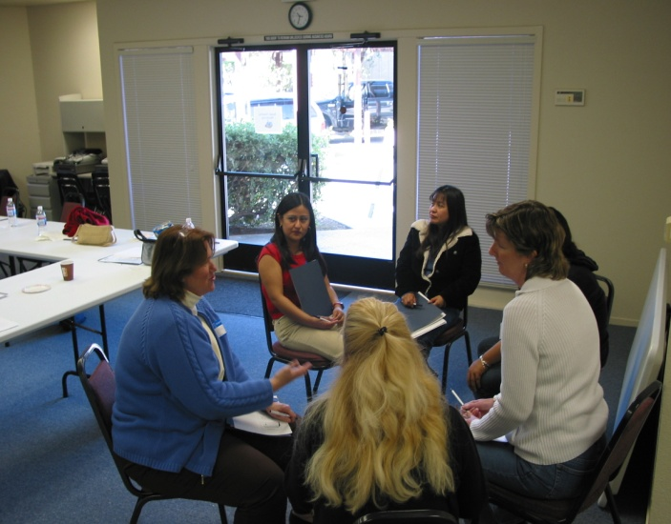
Time for Discussion/Q&A !
You’re invited to:
Discuss what I’ve shared
Ask questions
Share your insights, examples, & experiences
ENJOY THE CONFERENCE!
Larry Lesser
www.math.utep.edu/Faculty/lesser/

Slide 110
Tips for a great conference!
Rate this presentation on the conference app www.nctm.org/confapp
Download available presentation handouts from the Online Planner! www.nctm.org/planner
Join the conversation! Tweet us using the hashtag #NCTMHouston

