Slide 1
“Teaching Statistics for Critical Engagement Beyond Classroom Walls” ICOTS-9 invited session 7A (see my 6-page paper in ICOTS9 proceedings)
Dr. Lawrence M. Lesser
The University of Texas at El Paso
Lesser@utep.edu
supported in part by Project UPLIFT (NSF/EHR/DUE #1140690)

Slide 2
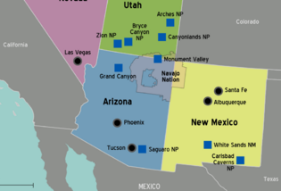
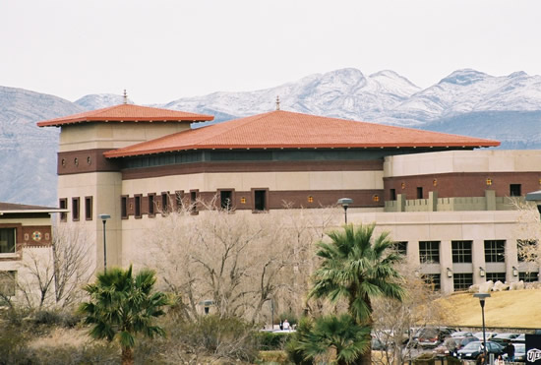
Notes:
2

Slide 3
presentation outline
Motivations/importance
Framework
Examples
Benefits
Future directions
Q & A

Slide 4
motivations & importance
Improve our own students’ motivation and engagement (UCLA study: 40%+ frequently bored in class)
Supplement/alternative to F2F teaching
Outreach to the broader public (e.g., ASA, CAUSE, Statistics2013, World of Statistics)
A way to show “data are not just numbers, they are numbers with a context” (Cobb & Moore, 1997)
Session 7A themes(lifelong learning, etc.)
Notes:
UCLA Higher Education Research Institute’s national survey of more than 250,000 freshmen at nearly 500 universities showed that over 40% of students said they are frequently bored in class (Berk, 2009)

Slide 5
Informal Science Education classification of out-of-classroom experiences (Braund & Reiss, 2006)
The actual world
A presented world
A virtual world
“a synchronous, persistent network of people, represented as avatars, facilitated by networked computers” (Bell, 2008)

Slide 6
presentation outline
Motivations/importance
Framework
Examples
Benefits
Future directions
Q & A

Slide 7
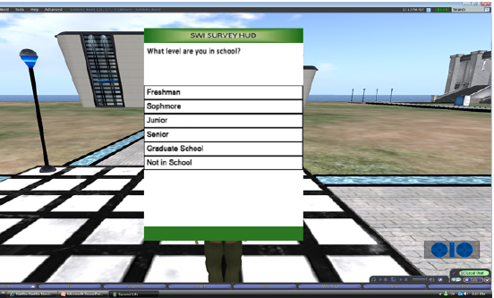
Virtual World: An Example
Practice sampling/survey/interview techniques in SecondLife.com (Bell, Castronova, Wagner, 2011):
Virtual Data Collection Interface(VDCI) Heads-Up Display (HUD) displays survey (via “survey kiosk”) then records participant’s answer

Slide 8
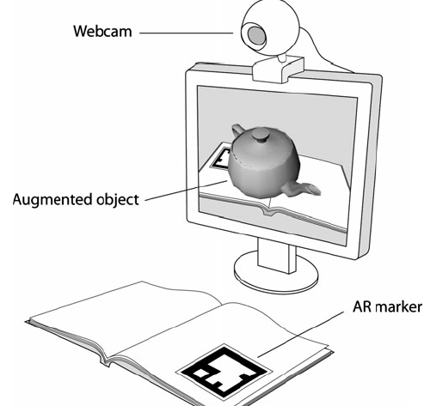
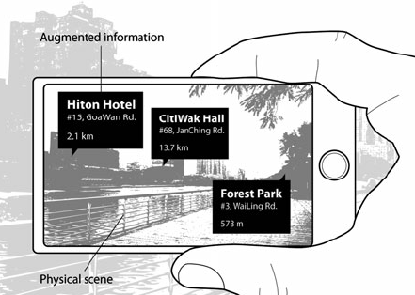
Augmented Reality(AR) connects Virtual and Actual World, can be image-based or location(e.g.,GPS)-based (figures from Cheng & Tsai, 2013)

Slide 9
ideas for Augmented Reality (AR)
Statistics textbook marker label activates via webcam capture
a virtual element to explore a 3-D scatterplot or distribution (by tilting and rotating the book)
superimpose data on mobile devices based on position

Slide 10
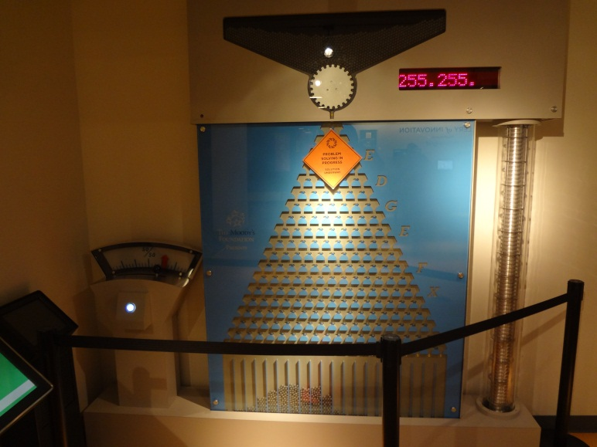
Presented World example: Museums
Science (e.g., Exploratorium) and
Math (National Museum of Mathematics) museums now include statistics/probability exhibits
(e.g., MoMath’s Edge FX Galton board
which includes lever that lets you
select where the balls fall)
SANKHYĀ National Museum of Statistics
to open at Univ. of Hyderabad (India)
Notes:
Digital display records how many balls land on R and L sides – see that distribution shape just moved to the left, based on the lever position

Slide 11
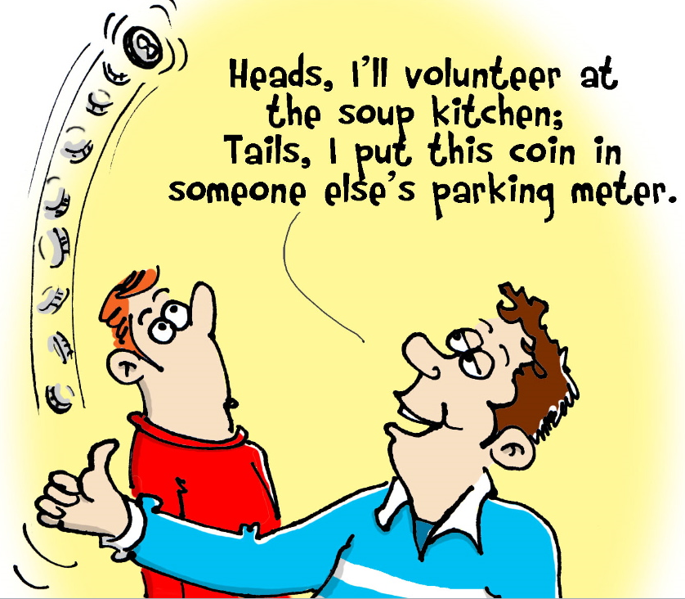
Presented World example: Museums/Libraries
Beyond exhibits: classes
Celebration events
UNSD launched quinquennial World Statistics Day 2010;
International Year of Statistics 2013→ World of Statistics;
February’s Random Acts of Kindness Week:

Slide 12
Presented World: Videos, TV, Radio, Podcasts
COMAP(1989) Against All Odds
statsandstories.net (Miami University)
NBC Learn
Mythbusters (e.g., “3 doors game” episode)
amstat.org/youtube/
Khan Academy

Slide 13
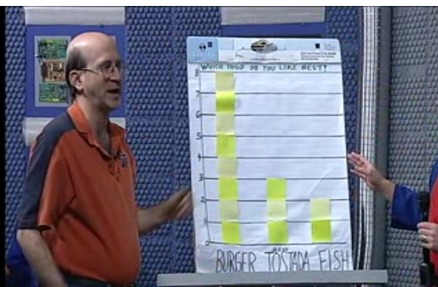
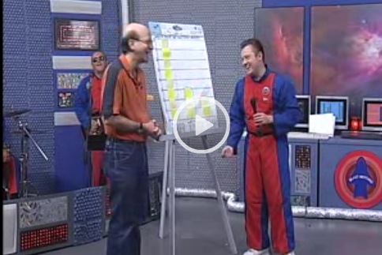
Presented world: my 2012 episode on polls and surveys
on local PBS-TV show “Blast Beyond”

Slide 14
Presented World: Songs (on CAUSEweb.org)
TITLE | TOPIC
Call Me It Maybe | variation
Mean | median better than mean for data with skewness/outliers
The Gambler | lottery literacy
MLE Let it Be | MLE properties
Hit Me with Your Best Shot Plot | graphing
Mexican Y Hat Dance | line of fit (notation & process)
Happy Birthday to You Song | Birthday Problem
One is the Loneliest Likeliest Number | Benford’s law
1 in 2 | equiprobability bias

Slide 15
Actual World example: Data Collection Field Trips
Relate observations on community walk (Rubel, Chu, Shookhoff, 2011)
to data from http://factfinder2.census.gov, http://epa.gov/myenvironment/ (air, water, pollutants, etc.),
GIS data from myworldgis.org (Enyedy’s Community Mapping Project),
Racial Dot Map, etc.

Slide 16
Racial Dot Map http://demographics.coopercenter.org/DotMap/

Slide 17
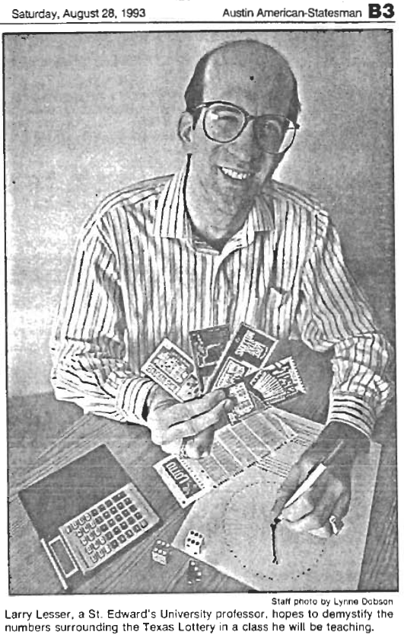
Actual World example: adult education outreach on Texas Lottery
adult education courses (UT-Austin, UT-El Paso)
pieces in 5 education journals:
TV/radio/magazine interviews
(award-winning) YouTube video
Lottery Literacy webpage
http://www.math.utep.edu/Faculty/lesser/lottery.html
song parody “The Gambler”
J. of Statistics Education | March 2013
Mathematics Teacher | Sept. 2012
Statistics Teacher Network | Winter 2004
Texas Mathematics Teacher | Fall 2003
Spreadsheet User | Nov. 1997

Slide 18
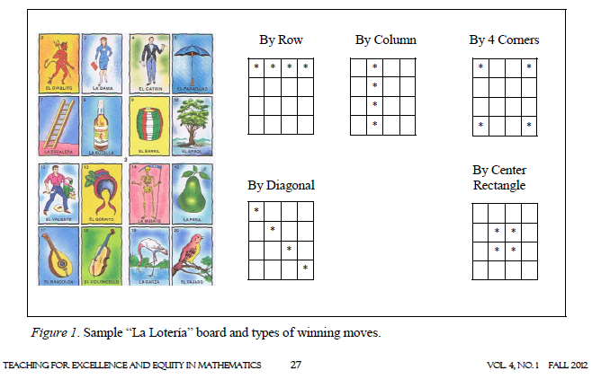
Actual World example: culturally relevant family math learning event (Ramirez & McCollough, 2012)

Slide 19
La Lotería questions (Ramirez & McCollough, 2012; Lesser 2013)
How many ways to win?
How many different 4x4 boards are there if the 16 cells must be different and drawn from a set of 54 images?
What’s [largest; smallest] number of cards dealer could call before your board [must; could] win?
What’s Pr(neither of first 2 cards called are on your 4x4 board)?

Slide 20
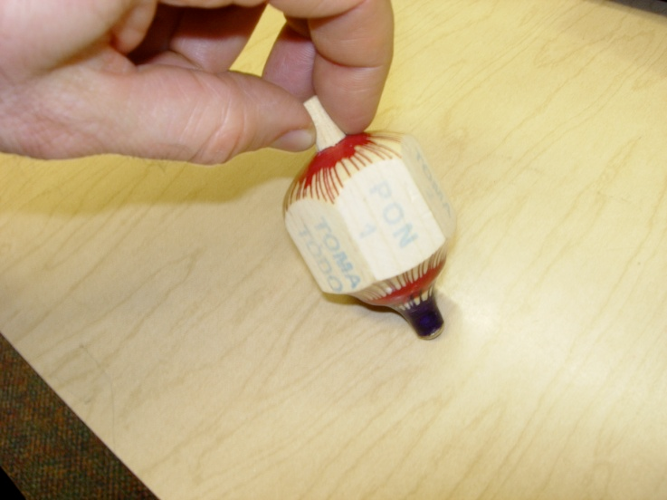
the Mexican game of Toma Todo
face of pirinola | result (S = spinner)
Toma Todo | S takes all
Toma Uno | S takes 1
Toma Dos | S takes 2
Pon Uno | S puts in 1
Pon Dos | S puts in 2
Todos Ponen | Each puts in 2

Slide 21
Toma Todo questions (Lesser 2010)
If pot starts with N chips (say, 2 from each player), what is the EV of what is won by the player doing the very first spin?
Does the second player to spin have expected winnings that are less, more or the same as the first player?

Slide 22
(Hanukkah) dreidel game
face of dreidel | Action (S = spinner)
Gimel | S gets all
Hay | S gets half
Nun | nothing
Shin | S puts in 1

Slide 23
Actual World example: sports/games
statistics courses on sports (Tabor & Franklin, 2012; Wiesner, 2013) or a particular sport such as baseball (Albert, 2003; Rothman, 2012)
Shonda Kuiper’s NSF project “games with a purpose”: http://web.grinnell.edu/individuals/kuipers/stat2labs/Labs.html

Slide 24
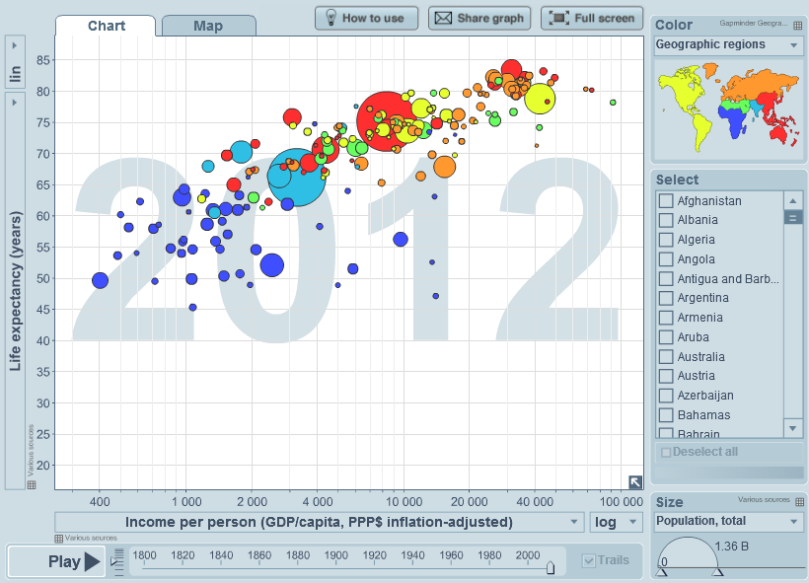
Actual World example: engaged citizenship
Social justice (e.g., Lesser in March 2007 JSE)
Service learning (e.g., Amy Phelps in Nov. 2012 JSE)
Gapminder.org

Slide 25
presentation outline
Motivations/importance
Framework
Examples
Benefits
Future directions
Q & A

Slide 26
BENEFITS of out-of-class experiences
Students own/control learning by hitting pause/rewind, take in more info through multiple input channels (Petty, 2010)
Extended practical work, active learning
Motivation
Contextualize, set up, and increase time for (flipped) in-class experiences
Hone teacher skills to cultivate engagement, incorporate questions, make real-world connections, tailor to student backgrounds

Slide 27
Benefits of out-of-classroom contexts (Braund & Reiss, 2006)
Improved development and integration of concepts
Extended and authentic practical work
Access to rare material and to “big” science data
Attitudes to school science: stimulating further learning
Social outcomes: collaborative work and responsibility for learning

Slide 28
pitfalls of informal contexts
Learning may not be substantial
Misconceptions may be initiated/fostered
Agenda may be on engagement more than on educational gains

Slide 29
FUTURE DIRECTIONS
Address the pitfalls on the previous slide
Broaden collection (e.g., add non-US examples)
Give implementation guidelines
Collect data on examples’ effectiveness to motivate learning, improve attitudes, decrease anxiety towards statistics
[one result (p = .04) from our NSF study:
exposure to songs in LMS increased learning;
see ICOTS9 poster #40 and eCOTS breakout session]

Slide 30
Thank you for coming! QUESTIONS?
“Teaching Statistics for
Engagement
Beyond Classroom Walls”
Dr. Lawrence M. Lesser
The University of Texas at El Paso
Lesser@utep.edu

Slide 32
“It’s a Sign: A Connection between Correlation and Slope” (students randomly assigned to include the red part or not)
The correlation coefficient r tells us something about the strength and linear relationship of a scatterplot of data. By strength, we mean how tightly the points cluster around the regression line (i.e., the line of best fit). All else being equal, a correlation value of r = .7 (or r = -.7) generally indicates a stronger linear relationship than a value such as r = .3 (or r = -.3).
The direction of the relationship has to do with the sign of r. If r > 0, we have positive correlation, which means higher values of Y are associated with higher values of X, and lower values of Y are associated with lower values of X. In other words, X and Y go up and down together. Such a scatterplot would be described best with a line of fit that has a positive slope, and indeed this is always the case: positive correlation happens when the regression line slope is positive. Likewise, r < 0 means negative correlation, with X and Y moving in opposite directions from each other, thus suggesting a line of fit with a negative slope. Finally, a scatterplot with no real linear trend at all (i.e., r = 0) would have a line of fit that is horizontal, which means slope of 0. Whether positive, negative, or zero, the sign of the correlation r is the same as the sign of the slope of the line.
Here are lyrics to a song (sung to the tune of the familiar folk tune “Twinkle, Twinkle Little Star” that helped you learn the alphabet) to help you rehearse and permanently acquire this fact in your mind:
Correlation Song (lyric © 2013 Lawrence M. Lesser)
Are points near a line, or far?
What’s the correlation, r?
If the fit supports a line,
Its slope and r would share the sign.
Twinkle, twinkle, you’re a star:
Knowing stats will take you far!
Click on this MP3 file http://www.causeweb.org/resources/fun/db.php?id=487 so you can hear this 20-second jingle.
Now play it one more time (and sing along!).

Slide 33
Project UPLIFT: three urban settings
 | Two-Year College | University (medium-size) | University (large)
Region of U.S. | Southeast | Southwest | Midwest
Student population | mostly Black | mostly Hispanic | general U.S. demographic
Type of course | Statistical literacy | Statistical literacy | Statistical literacy
Main audience | General education | Pre-service teachers | Arts and humanities
Text | Sullivan’s Fundamentals of Statistics: Informed Decisions Using Data | Utts’ Seeing Through Statistics | Moore & Notz’s Statistics: Concepts & Controversies
Learning management system | Desire2Learn | Blackboard | Desire2Learn

Slide 34
student-randomized experiment (fall 2013) (53 from comm. college; 194 from medium-sized university)
All students asked to take pre-tests:
SATS (Survey of Attitudes Toward Statistics), SAM (Statistics Anxiety Measure)
Half of the students randomized to have “fun inserts” in content readings accessed via LMS
All students take midterms/finals with embedded multiple-choice items related to the (12-14) content readings
All students asked to take post SATS & SAM

Slide 35
% Correct with and without Song Inserts
Topic | Without song | With Song | Difference
Margin of error: down with n down by √n | 57.3% 9.1% | 61.3% 10.0% | 4.0% 0.9%
Standard score | 62.5% | 75.0% | 12.5%
Correlation & slope | 60.2% | 73.8% | 13.6%
Equiprobability bias | 40.9% | 50.0% | 9.1%
Multiplicity | 36.1% | 37.0% | 0.9% (medium university)
p-value | 44.4% | 50.0% | 5.6% (2-yr. college)
OVERALL | 42.3% | 50.0% | 7.7%
80% CI on total difference (2.8%, 12.6%) p-value ≈ 0.04

Slide 36
Why did some fun items appear more effective than others?
Spearman’s Rank Correlation of “Effectiveness” with “Activeness”
from two independent raters:
0.61 and 0.66

