Slide 1
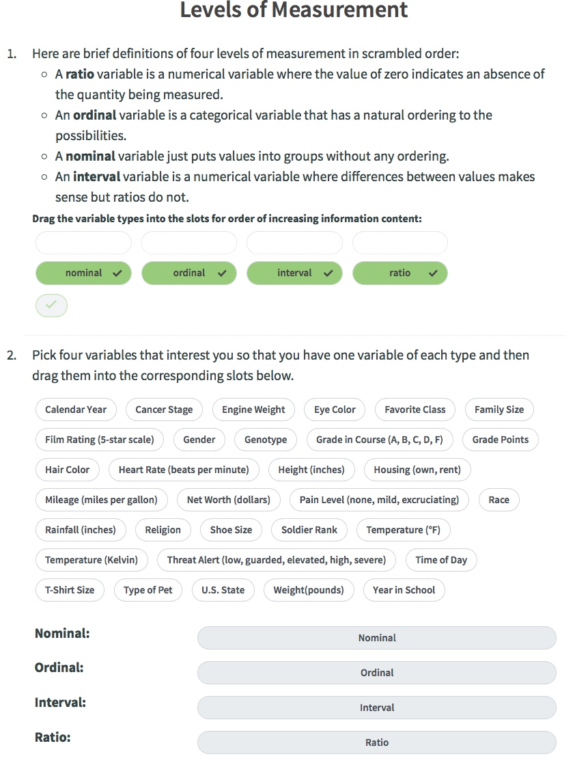
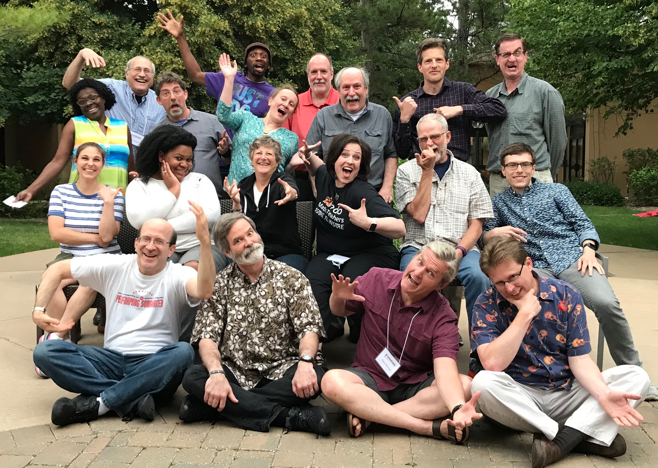
Stats and beyond: using song in STEM Dennis K. Pearl, Lawrence M. Lesser, John J. Weber, Penn State University, University of Texas at El Paso, Georgia State University Perimeter College
Background:
Using song in higher education spans many scientific disciplines (e.g. www.CAUSEweb.org/voices) and has many putative benefits, including reduced stress or anxiety, improved recall, and increased motivation or engagement (Crowther et al., 2016; Crowther, 2016; Lesser, 2014). This has led an interdisciplinary group of educators to form the VOICES initiative to host annual virtual conferences, create a database of instructional songs and learning materials, implement a regular survey on the use of song in STEM, and disseminate these efforts.
(www.CAUSEweb.org/voices)
In statistics, based on prior findings (Lesser et al., 2016), we have developed a new web-based resource for teaching with song where students interact with online prompts to make conceptual connections and provide examples that become part of a song highlighting their contributions (www.CAUSEweb.org/smiles). Twenty-eight songs covering most introductory statistics topics were developed along with the associated prompts and assessment items to test their efficacy for learning (Figure 2).
Motivation:
Interactive songs are a novel learning resource that holds great potential for teaching literacy and reasoning skills in statistics and other STEM disciplines. The web-based, machine-run, and auto-graded characteristic of this resource is designed to provide easy access to students anywhere anytime, and will address instructor hesitations regarding in-class use. For instructors, interactive songs will be readily adaptable regardless of pedagogy (e.g., as easily incorporated in a flipped class as in an online class, or a lecture/lab course), and provide an easily implemented bridge to the statistics education reform movement for groups like adjuncts who are less connected. Most importantly, for students, these professional-quality interactive songs are designed to engage, lessen anxiety, and foster active learning that enhances statistical reasoning skills. To enhance their value, the interactive songs developed by the SMILES project involved a unique artist/scientist collaborative to create original high-quality musical resources.
Emails: smiles@CAUSEweb.org
(including requests for instructor resources)
and leadvoices@CAUSEweb.org
Student-Made Interactive Learning with Educational Songs
Results using Web Logfiles
Using xAPI logfiles allows us to examine how students interact with the software. By seeing where students struggle, we can design better feedback and hints – which become especially important when the interactive songs are used outside of class. As expected, students using the interactive songs in-class with a facilitator overwhelmingly completed all of the prompts in a single session while students at home were less likely to do so. The value added by the songs can be seen in the percentage of students giving correct responses to specific prompts and then asking about the same material in a different context after the song activity (Table 1).
Ninety students from two institutions (one research university and one two-year college) were asked to respond to Likert scale items on agreement with key project goals. Students self-reported the tool was helpful in reducing anxiety, increasing engagement with the material, being relevant to their learning, and having a user-friendly interface.
Figure 1. Student Responses to Likert Items in Student Feedback Study
Table 1. Completion Rates & Assessment Results
Beyond Stat to STEM
Use a laptop on the table to explore song usage:
In STEM Karaoke and Performance mode,
As a learning resource for labs and homework,
Integrated with online activities (as in SMILES), or
As a vehicle for student projects.
assessment item.
Figure 2. Example Prompts and Assessment
Curated Resources?
Evidence?
Examples?
Lessons?
Recordings?
What would help change the rhythm of your teaching?
The screenshot above shows another song’s prompts interface, which has an example of machine-generated feedback and a hint button. The screenshot to the right shows a song’s matching assessment item.
The screenshots above and to the left show a song’s pre-song prompts interface and the playback interface (with student inserts highlighted).
References Crowther, G.J. (2016). Educating with music: Relevant reading. http://singaboutscience.org/wp/educating/research Crowther, G., McFadden, T., Fleming, J. & David, K. (2016). Leveraging the power of music to improve science education. International Journal of Science Education, 38(1), 73-95. | Lesser, L. (2014). Mathematical lyrics: Noteworthy endeavours in science education. Journal of Mathematics and the Arts, 8(1-2), 46-53. Lesser, L.M., Pearl, D.K., & Weber, J.J. (2016). Assessing fun items’ effectiveness in increasing learning of college introductory statistics students: Results of a randomized experiment. Journal of Statistics Education, 24(2), 54-62.
assessment item.
Virtual Ongoing Interdisciplinary Collaborations on Educating with Song
Browse 3 days of archived content from VOICES 2017 and 2018
and save September 22 & 23 for VOICES 2019!
Acknowledgements This work is supported by NSF grants #1544426, #154437, #1544243, and #1748129. Opinions, findings, and conclusions are those of the author and not necessarily those of the NSF. We are also grateful for the many contributions from other members of our team (see: www.CAUSEweb.org/smiles/team).

