Slide 1
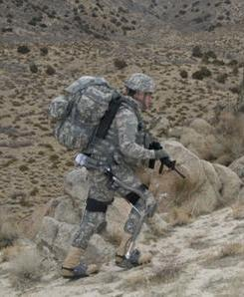
EXOSKELETON – FOR THE FUTURE OF SUPER SOLDIRES
CPT Richard O. Adansi
University of Texas at El Paso
Department of Mathematical Science (CPS 5195)
7th October, 2009

Slide 2
AGENDA
Introduction
Development
Significance of Development
Challenges of Development
Recommendation
Conclusion
References

Slide 3
INTRODUCTION
Exoskeletons have been around for millions of
years
Human limitations fatal on the battlefield
Exoskeleton amplifies strength, endurance,
agility and protection
In the 1960s, GE and the U.S. Military co- developed
Hardiman

Slide 4
DEVELOPMENT
Solely involves multi-disciplinary work
Control Algorithm
Electronics
Power source
    autonomous hydraulic and electrical

Slide 5
DEVELOPMENT
Design
device interfaces with its human operator on physical level
  requires robustness for extreme operating conditions and environment
  Gait Analysis of human gaits primarily used for the physical requirements

Slide 6
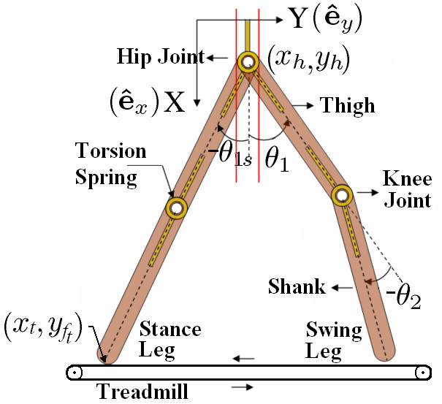
DEVELOPMENT
Analysis of the dynamics of human walk

Slide 7




DEVELOPMENT
Hip Motion
If the treadmill moves at a constant speed v, the position of the contact point of the stance leg with the treadmill, Y_{ft} at time t, is given as
where is the position of the contact point at the start of the stance phase. Let x_{t} be the position of treadmill in the direction. Using kinematics, we write the vertical position of the hip as
Hip angle during stance phase θ_{1s} is given as
Equations of Motion
Swing leg dynamics can be written using the Lagrange equations.
where τ_{i} denotes the external torque applied at the joints. The Lagrange function given in the above equation is defined as
Where
In the above equation, and are unit vectors along X and Y axes.
Note that while finding the device parameters from simulations we assume that the external torque τ_{i} applied is zero and based on the above dynamics we find θ_{i}(t). Whereas while analyzing the experimental results, based on the encoders data we know θ_{i}(t). We use this information to calculate the external torque τ_{i}, more specifically the human applied component. In the later case, external torque τ_{i} can be treated as a summation of device interface torques τ_{FT} (which is known as it is recorded by Force-Torque (F/T) sensors) and the human applied torque τ_{h}. Based on the dynamic equations we can estimate human applied torque τ_{h}.

Slide 8
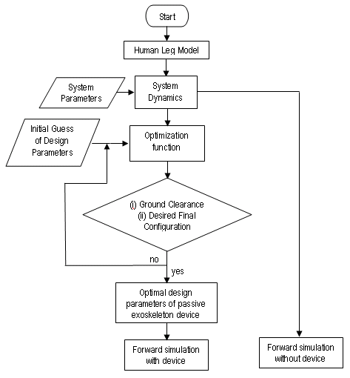
DEVELOPMENT

Slide 9
SIGNIFICANCE OF DEVELOPMENT
Device has great potential of applications
  Military
  Non-military
    Medical field
    Fire firefighters
    Factory workers
    Police department
    Disaster relief workers

Slide 10
CHALLENGES OF DEVELOPMENT
Cost - no estimate given for mass production
Power – zero noise source/short battery life
Structural materials- be capable of protection
Frame design – should have joint to be like humans

Slide 11
RECOMMENDATIONS
cost- encourage competition to reduce cost
structural material- strong, lightweight and flexible
Power – enough to run for at least 24 hour
Control – seamless control; users can function

Slide 12
RECOMMENDATIONS
Actuation – actuators must be quiet and efficient
Biomechanics – device must be able to react to human
motion
GPS receivers – for navigation and info on terrain

Slide 13
CONCLUSION
Breakthrough research could soon bring relief
  exoskeleton will be developed to be
    ergonomic
    highly maneuverable
    technically robust without reduction in agility.
    There are breakthrough technologies
      computers and cell phones
      Exoskeleton is and will be history

Slide 14
REFERENCES
U.S. Defense Advanced Research Projects Agency (DARPA)
http://science.howstuffworks.com/exoskeleton.htm/printable
http://www.jneuroengrehab.com/content/6/1/24
http://www.powerskip.de
http://www.cyberdyne.jp

Slide 15
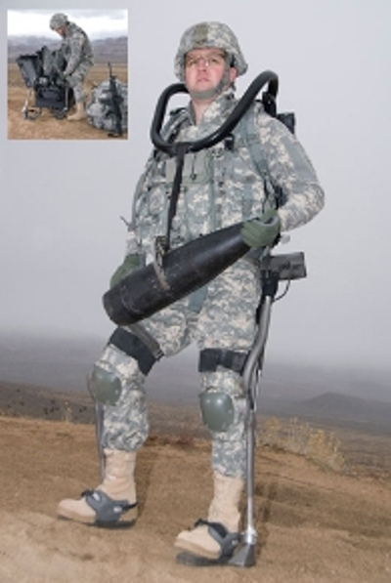
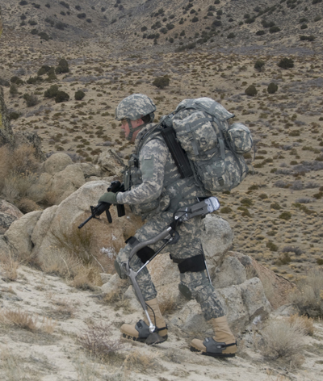
QUESTIONS ???

