Slide 1
University of Texas At El Paso
A Simple Algorithm for reliability evaluation of a stochastic-flow network with node failure
By Yi-Kuei Lin
Oswaldo Aguirre

Slide 2
Introduction
Networks are series of points or NODES
interconnected by communication paths or LINKS
G = (N,L)
Where:
N= number of nodes
L= number links
1≤ N ≤ ∞
0≤ L ≤ ∞
G = (7,7)

Slide 3
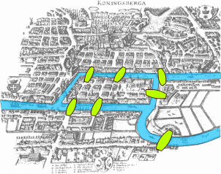
Introduction (CONT’D…)
Network applications:
  Distribution networks
  Transportation networks
  Telecommunication networks
Network problems
  Shortest path
  Network flow
  Network reliability

Slide 4

Problem description
Network reliability: The probability that a message can be sent
from one part of the network to another

Slide 5
Problem description (CONT’D…)
Binary state
Multistate
Links have two states 0/1
Insufficient in obtaining reliability models that resemble the behavior of the system
Components can have a range
of degraded states
X = (x₁,x₂,x₃,…….x_{n})
More accurate results to real behavior

Slide 6
Methodology (CONT’D…)
Minimal cut vector (MC):
It is a set of components for which the repair of any failed components results in a functioning system
a8
Minimal Cuts:
a1,a5
a1,a7
a5,a8
a2,a3,a5
a1,a4,a6
a2,a6
a2,a7
a6,a8
a7,a8
a1
a1
a7
a3
a4
a10
a5
a6
a9

Slide 7
Methodology (CONT’D…)
Minimal path vector (MP):
A minimal path vector is a path vector for which the failure of any functioning components results in system failure
a8
Minimal Paths
a7,a1,a8,a2,a10
a7,a1,a8,a3,a9,a6,a10
a7,a5,a9,a6,a10
a7,a5,a9,a4,a8,a2,a10
a1
a1
a7
a3
a4
a10
a5
a6
a9

Slide 8
Algorithm
a8
a1
a1
Find the system reliability.
When the network can transmit at least 5 messages or demand (d)>4
Using minimal path sets
a7
a3
a4
a10
a5
a6
a9
Minimal Paths
a7,a1,a8,a2,a10 f1
a7,a1,a8,a3,a9,a6,a10 f2
a7,a5,a9,a6,a10 f3
a7,a5,a9,a4,a8,a2,a10 f4

Slide 9
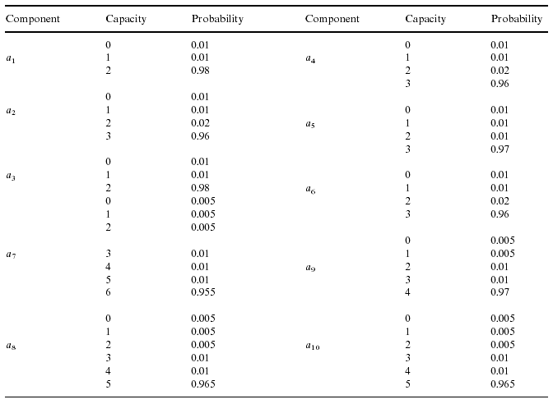
Algorithm (CONT’D…)

Slide 10
Algorithm (CONT’D…)
Step 1: find solutions that satisfy the following conditions
  Each flow (fj) <= max capacity of the Minimal path (MPj)
  f1 <= Max cap MP1 (a7,a1,a8,a2,a10)=(6,2,5,3,5) <= 2
  f2 <= Max cap MP2 (a7,a1,a8,a3,a9,a6,a10)=(6,2,5,3,4,3,5) <= 2
  f3 <= Max cap MP2 (a7,a5,a9,a6,a10)=(6,3,4,3,5) <= 3
  f4<= Max cap MP2 (a7,a5,a9,a4,a8,a2,a10)=(6,3,4,3,5,3,5) <= 3
a1 | a2 | a3 | a4 | a5 | a6 | a7 | a8 | a9 | a10
2 | 3 | 2 | 3 | 3 | 3 | 6 | 5 | 4 | 5

Slide 11
Algorithm (CONT’D…)
Step 1: find solutions that satisfy the following conditions
  ∑( fj | ai ∈ MPj) <= Max Cap. Of Component i
    ∑( fj | a1 ∈ MPj) = f1 + f2 <= 2
    ∑( fj | a2 ∈ MPj) = f1 + f4 <= 3
    ∑( fj | a3 ∈ MPj) = f2 <= 2
    . . . .
    . . . .
    . . . .
    ∑( fj | a10 ∈ MPj) = f1 + f2 + f3 +f4 <= 5
  f1+f2+f3+f4=5

Slide 12
Algorithm (CONT’D…)
Step 1: find solutions that satisfy the following conditions
  (2,0,3,0),(2,0,2,1),(1,1,2,1),(1,1,1,2),(0,2,1,2) and (0,2,0,3)
Step 2: Transform F into X (a1,a2,a3,a4,a5,a6,a7,a8,a9,a10)
a1= f1 + f2 a4= f4 a7=a10=f1+f2+f3+f4
a2= f1 + f4 a5= f3+ f4 a8=f1+f2+f3
a3= f2 a6= f2+f3 a9=f2+f3+f4
Thus:
X1 = (2,2,0,0,3,3,5,2,3,5) X2 = (2,3,0,1,3,2,5,3,3,5)
X3 = (2,2,1,1,3,3,5,3,4,5) X4 = (2,3,1,2,3,1,5,4,4,4)
X5 = (2,2,2,2,3,3,5,4,5,5) X6 = (2,3,2,3,3,2,5,5,5,5)

Slide 13
Algorithm (CONT’D…)
Step 3: Remove non minimal ones (X) to obtain lower boundary points
X₁=(2,2,0,0,3,3,5,2,3,5) X₂=(2,3,0,1,3,2,5,3,3,5)
X₁=(2,2,0,0,3,3,5,2,3,5) <= X₃=(2,2,1,1,3,3,5,3,4,5)
X₁=(2,2,0,0,3,3,5,2,3,5) X₆=(2,3,2,3,3,2,5,5,5,5)

Slide 14
Algorithm (CONT’D…)
Step 4: Obtain Reliability of the system
  After selecting only 2 vectors:
X1 = (2,2,0,0,3,3,5,2,3,5)
X2 = (2,3,0,1,3,2,5,3,3,5)
  The reliability of the system can be evaluated using the inclusion exclusion formula
P(X1 U X2 ) = P(X1) + P(X2) – P(X1X2)
  The reliability that the system can send at least 5 units of flow is 0.824241

Slide 15

Questions

