Slide 1
Harmonic Motion
© 2010, 2011, 2013 Eric Freudenthal and Art Duval

Slide 2
Weight on spring
Spring constant (K) = 1
Force = -40
Position (P) =40
F = -K * P
A = F / M
+40
Bounces
+/- 40
Mass (M) = 100
0
Force = +40

Slide 3
Computing changes in position
Constants
K: spring constant (N/m)
M: mass (kg)
Variables
P: position (m)
F: force (N)
A: acceleration (m/s)
V: velocity (m/s²)
From previous slide:
  F = -K*P
  A = F/M
A = -K*P/M
Speed change in 1s
  V = V + A * 1.0
Position change 1s
  P = P + V * 1.0
open Impact; origin (50.0,100.0)
k <- 1.0; m <- 100.0
t <- 0.0
v <- 0.0; p <- 40.0
while t < 150.0 do
dot (t,p) red
a <- -p * k / m
v <- v + a * 1.0
p <- p + v * 1.0
t <- t + 1.0
Can be copied from http://impactstem.org/resonance

Slide 4
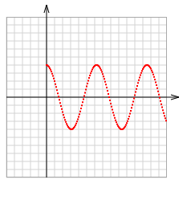
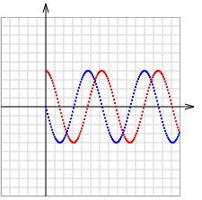

Relating position and velocity
open Impact; origin (50.0,100.0)
k <- 1.0; m <- 100.0
t <- 0.0
v <- 0.0; p <- 40.0
while t < 150.0 do
dot (t,p) red
a <- -p * k / m
v <- v + a * 1.0
p <- p + v * 1.0
t <- t + 1.0
open Impact; origin (50.0,100.0)
k <- 1.0; m <- 100.0
t <- 0.0
v <- 0.0; p <- 40.0
while t < 150.0 do
dot (t,p) red
dot (t,v*10.0) blue
a <- -p * k / m
v <- v + a * 1.0
p <- p + v * 1.0
t <- t + 1.0
Period (time to repeat)
Stationary when Position extreme
Goes on forever…
Position
Amplitude=40
Position
T (seconds)
Velocity
T (seconds)
Turning points
Fastest when Position at middle
$$0$$

Slide 5

Relating position and velocity
open Impact; origin (50.0,100.0)
k <- 1.0; m <- 100.0
t <- 0.0
v <- 0.0; p <- 40.0
while t < 150.0 do
dot (t,p) red
dot (t,v*10.0) blue
a <- -p * k / m
v <- v + a * 1.0
p <- p + v * 1.0
t <- t + 1.0
open Impact; origin (50.0,100.0)
k <- 1.0; m <- 100.0
t <- 0.0
v <- 4.0; p <- 0.0
while t < 150.0 do
dot (t,p) red
dot (t,v*10.0) blue
a <- -p * k / m
v <- v + a * 1.0
p <- p + v * 1.0
t <- t + 1.0
Starts at top (with velocity=0)
Starts at P=0 at maximum speed
Position
Velocity
T (seconds)
Position
T (seconds)
Velocity
Equivalent “phases”

Slide 6

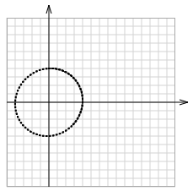
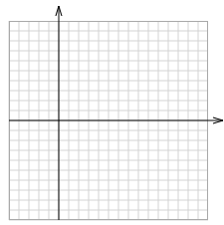
Plotting Velocity v. Position
open Impact; origin (50.0,100.0)
k <- 1.0; m <- 100.0
t <- 0.0
v <- 4.0; p <- 0.0
while t < 150.0 do
dot (t,p) red
dot (t,v*10.0) blue
a <- -p * k / m
v <- v + a * 1.0
p <- p + v * 1.0
t <- t + 1.0
open Impact; origin (50.0,100.0)
k <- 1.0; m <- 100.0
t <- 0.0
v <- 4.0; p <- 0.0
while t < 150.0 do
dot (v*10.0,p) black
a <- -p * k / m
v <- v + a * 1.0
p <- p + v * 1.0
t <- t + 1.0
P
0
0
0
180
180
90
Velocity
time
Position
T (seconds)
0
V
90
90
90
180
270
270
270

Slide 7

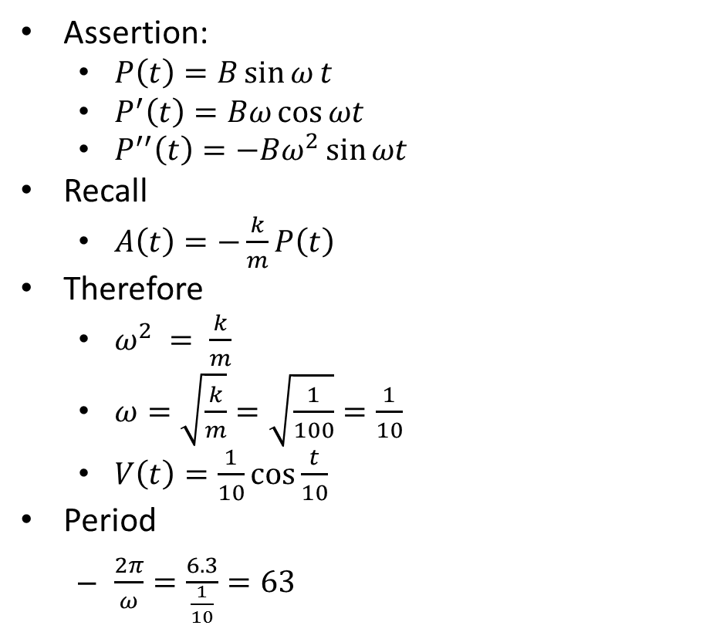


With calculus, this makes sense
Assertion:
  $P\left(t\right)=B\sin{ω}t$
  $P^{′}\left(t\right)=Bω\cos{ωt}$
  $P^{′′}\left(t\right)=−Bω^{2}\sin{ωt }$
Recall
  $A\left(t\right)=−\frac{k}{m}P\left(t\right)$
Therefore
  $ω^{2} = \frac{k}{m}$
  $ω=\sqrt{\frac{k}{m}}=\sqrt{\frac{1}{100}}=\frac{1}{10}$
  $V\left(t\right)=\frac{1}{10}\cos{\frac{t}{10}}$
Period
  $\frac{2π}{ω}=\frac{6.3}{\frac{1}{10}}=63$
Velocity
$$V\left(t\right)=$$
Position
$$A\left(t\right)=$$
  $$=−ω^{2}P(t)$$
k <- 1.0; m <- 100.0
t <- 0.0
v <- 4.0; p <- 0.0
while t < 150.0 do
dot (t,p) red
dot (t,v*10.0) blue
a <- -p * k / m
v <- v + a * 1.0
p <- p + v * 1.0
t <- t + 1.0

Slide 8

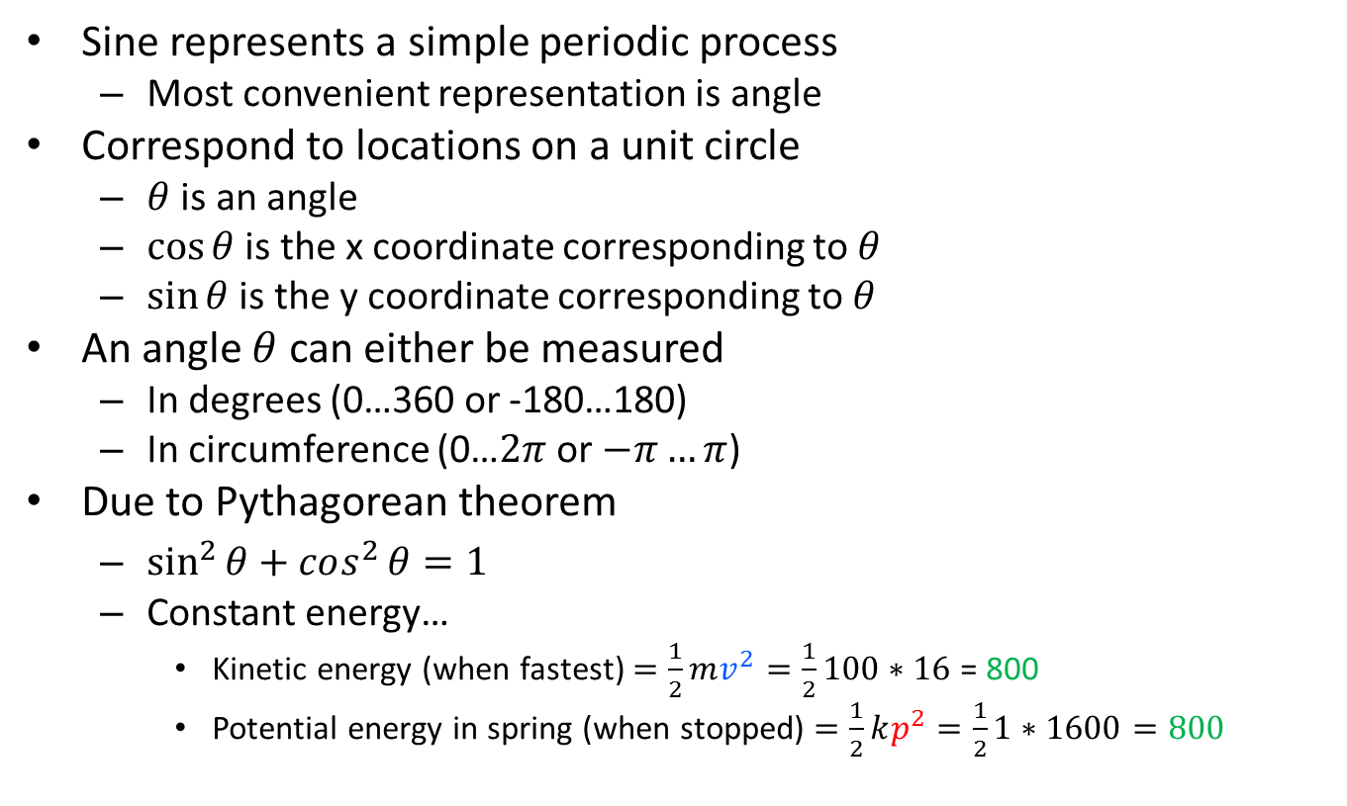

So, what do we make of this?
Sine represents a simple periodic process
  Most convenient representation is angle
Correspond to locations on a unit circle
  $θ$ is an angle
  $\cos{θ}$ is the x coordinate corresponding to $θ$
  $\sin{θ}$ is the y coordinate corresponding to $θ$
An angle $θ$ can either be measured
  In degrees (0…360 or -180…180)
  In circumference (0…$2π$ or $−π…π$)
Due to Pythagorean theorem
  $\sin^{2}{θ+cos^{2}{θ=1}}$
  Constant energy…
    Kinetic energy (when fastest) $=\frac{1}{2}mv^{2}=\frac{1}{2}100∗16$ = 800
    Potential energy in spring (when stopped) $=\frac{1}{2}kp^{2}=\frac{1}{2}1∗1600=800$
$$θ$$

Slide 9
Exercises (& Homework)
For each of the following, describe what happens and explain why
  If initially V is 0.5 or 2?
  If initially P=5 and V=1
  If M is doubled?
  If K is doubled
  If K & M are doubled?

